Slide 1
The ADM Board’s System of Care and Client’s Rights
Chris Freeman-Clark, MPA, MSW, LISW-S
Coordinator of Forensic Services
Co-Chair Summit County Hoarding Task Force
www.admboard.org
RECOVERY STARTS HERE.
March 2024

Slide 2
Introduction
www.admboard.org
RECOVERY STARTS HERE.

Slide 3
Topics
The ADM Board’s System of Care
Client’s Rights
“Forensic” Cases
Hoarding Disorder
www.admboard.org
RECOVERY STARTS HERE.

Slide 4
Successful, long-term recovery is built on a foundation of hope.
2017 Report to the Community, Summit County ADM Board
www.admboard.org
RECOVERY STARTS HERE.

Slide 5
Hopeful
www.admboard.org
RECOVERY STARTS HERE.

Slide 6
Hopeless
“Officers dispatched…ref fight between girlfriend and boyfriend. Subject 2 blocks from her home…wearing tank top and barefoot…temperature around 0. She was crying…states she cut her leg earlier to make herself bleed…has thoughts of suicide…she was raped at 5 years old…tonight took 2 Vicodin and 5-7 beers.”
APD CIT Jan 2010
www.admboard.org
RECOVERY STARTS HERE.

Slide 7
The ADM System of Care offers hope through timely access to treatment.
2017 Report to the Community, Summit County ADM Board
www.admboard.org
RECOVERY STARTS HERE.

Slide 8
Timely Access
Past | Present
2013—Central Assessment: 50 days average from call to Substance Use Disorder (SUD) assessment | 2023—Decentralized assessment: Most common wait is one day.
No follow up system for opiate overdoses (e.g., overdose, hospital treatment, discharge, death) | Quick Response Teams (QRT)* follow up with team contact within a week, decreasing cycling and intervening when motivation is high; Naloxone distribution *Currently, only 5 QRT are active.
www.admboard.org
RECOVERY STARTS HERE.

Slide 9
Treatment…But Not Just Any Kind of Treatment
Evidence-based practices (EBP)
Studied, scientifically validated
Cost effective
Participants and tax payers
Minimally invasive
See Client’s Rights
www.admboard.org
RECOVERY STARTS HERE.

Slide 10
EBP Fidelity and Outcomes
Is the EBP being implemented in a way that it was designed by the researchers?
Are we getting the expected outcomes from implementation of the EBP?
Case Western Reserve Fidelity Reviews
www.admboard.org
RECOVERY STARTS HERE.

Slide 11
Evidence-Based Intervention Examples
CET: Cognitive Enhancement Therapy
CBT: Cognitive Behavior Therapy
Mental Health Courts
Drug Courts
Medication
www.admboard.org
RECOVERY STARTS HERE.

Slide 12
How does Summit County offer hope through timely access to treatment?
www.admboard.org
RECOVERY STARTS HERE.

Slide 13
Local Levy
In 2022, 77% of the ADM Board’s disbursements came from a local property tax levy. The remaining funding is comprised of state and federal funding.
Approximately, $29,419,225 was distributed for addiction and mental health services in 2022.
www.admboard.org
RECOVERY STARTS HERE.

Slide 14
Agencies
Akron UMADAOP
Alliance for Healthy Youth
ARC Recovery Services
Asian Services in Action (ASIA)
Blick Center
Catholic Charities
CHC Addiction Services
Child Guidance and Family Solutions
Choices, A Community Social Center
Coleman Health Services
Community Support Services, Inc.
Greenleaf Family Center
IBH Addiction Recovery
Legacy III
Minority Behavioral Health Group
North Coast Community Homes
Ohio Guidestone
Oriana House
Portage Path Behavioral Health
Psycho-Diagnostic Clinic
Red Oak Behavioral Health
Shelter Care, Inc.
Summit County Community Partnership
Summit County Public Health
Summit Psychological Associates
Summit Recovery Hub RCO
Tarry House, Inc.
Truly Reaching You
Tyler’s Redemption Place RCO
Victim Assistance Program
www.admboard.org
RECOVERY STARTS HERE.

Slide 15
ADM Board Funds: Project Dawn (SCPH)
Overdose prevention, education, and harm reduction
Naloxone (Narcan) distribution
Offer community training events, harm reduction clinics, and online
Distributed 6,000 packages from October 2020-September 2021
www.admboard.org
RECOVERY STARTS HERE.

Slide 16
ADM Board Funds: Tarry House
16 bed residential treatment facility for SPMI
Group and individual recovery activities
Emphasis on daily living skills and social skills
Respite program for homeless individuals with mental health disorders who are at risk of hospitalization
Accepts discharge-ready patients who support to find living arrangements
www.admboard.org
RECOVERY STARTS HERE.

Slide 17
ADM Board Funds: CSS
Assertive Community Treatment
3 ACT teams
Case management
4 regional teams; geriatric, forensic team
Mental Health Court
Akron, Barberton, Stow, Hope Court
Homeless outreach
Serious mental health and substance abuse
Crisis and engagement team
Supported employment and three 24/7 group homes
www.admboard.org
RECOVERY STARTS HERE.

Slide 18
ADM Board Funds: ASIA
Started in 1995; largest in NE Ohio (currently)
Botvin LifeSkills, after school and summer
LifeSkills targets drug use, alcohol use, violence, and tobacco use
Language Education Program: bilingual mental health outreach to Bhutanese and Nepali population
www.admboard.org
RECOVERY STARTS HERE.

Slide 19
Questions: ADM Board’s System of Care?
www.admboard.org
RECOVERY STARTS HERE.

Slide 20
Client’s Rights (see OAC 5122-26-18)
Every individual is protected by a system of rights.
“…treated with consideration, respect for personal dignity, autonomy and privacy.”
“To be treated in the least restrictive, feasible environment”
www.admboard.org
RECOVERY STARTS HERE.

Slide 21
Examples of Client’s Rights (see OAC 5122-26-18)
Participation in treatment and planning; get a copy
The right to be “informed of one’s own condition”
The right to be informed of the reason for denial of services
The right to file a grievance
Confidentiality of communications and personal identifying information
Source: CSSbh.org
www.admboard.org
RECOVERY STARTS HERE.

Slide 22
ADM Board Contact
Holly Cundiff, Care Access/Client Rights Coordinator
Phone: 330-564-4087
Email: hcundiff@admboard.org
www.admboard.org
RECOVERY STARTS HERE.

Slide 23
Questions: Client’s Rights?
www.admboard.org
RECOVERY STARTS HERE.

Slide 24
Question
What do you call a defendant who is incapable of understanding the nature and objectives of the proceedings against him?
www.admboard.org
RECOVERY STARTS HERE.

Slide 25
Trick Question!
Incompetent to stand trial: A defendant who is incapable of understanding the nature and objectives of the proceedings against the defendant or of assisting in his defense.
www.admboard.org
RECOVERY STARTS HERE.

Slide 26
Question
What happens if a judge, attorney, or prosecutor raises the question of incompetency?
www.admboard.org
RECOVERY STARTS HERE.

Slide 27
Answer
The Court orders Psycho-Diagnostic clinic to complete a competency evaluation.
PDC has 30 days to complete the evaluation.
www.admboard.org
RECOVERY STARTS HERE.

Slide 28
Question
What happens if the defendant, as the result of symptoms of a mental health disorder or another reason, does not cooperate with the competency examination?
www.admboard.org
RECOVERY STARTS HERE.

Slide 29
Answer
The court orders the defendant to Northcoast for up to 20 days to complete the competency evaluation.
www.admboard.org
RECOVERY STARTS HERE.

Slide 30
Court Findings
Incompetent to Stand Trial
The court orders the defendant to undergo competency restoration treatment at Northcoast (inpatient) or Summit Psychological Associates (outpatient)
www.admboard.org
RECOVERY STARTS HERE.

Slide 31
Restoration Treatment
Maximum Time
Felony 1 or 2, violent = year
Felony 3, 4, or 5 = 6 months
Misdemeanor 1 or 2 = 60 days
All other misdemeanors = 30 days
www.admboard.org
RECOVERY STARTS HERE.

Slide 32
What if…
The defendant is not restored to competency?
Felony 1 or 2, violent: The court can maintain jurisdiction over the defendant for the longest period of time had the defendant been found guilty of the most serious crime. “ISTU-CJ”
Lesser charges? Dismissed. Probate?
www.admboard.org
RECOVERY STARTS HERE.

Slide 33
Ohio Revised Code “NGRI”
R.C.2901.01(A)(14): “A person is not guilty by reason of insanity…if the person proves…by a preponderance of the evidence, that at the time of the commission of the offense, the person did not know, as a result of a severe mental disease or defect, the wrongfulness of the person’s acts.”
www.admboard.org
RECOVERY STARTS HERE.

Slide 34
Not Guilty by Reason of Insanity/ISTU-CJ
44 NGRI or ISTU-CJ clients (28 NGRI, 16 ISTU-CJs)
Commitment length: 1 year to life
Life (longest) n=13
25 NC, Heartland, Twin Valley, and Warrensville Dev Center
19 on conditional release now in Summit and Franklin Counties
4 murder/attempted murder/rape
4 arson/aggravated arson
5 assault
6 robbery/burglary
www.admboard.org
RECOVERY STARTS HERE.

Slide 35
NGRI Clients
Defendants are often doing what they perceive to be “the right thing” or they or a loved one will somehow be harmed.
NGRI acquitees often feel intense guilt about their crime once stabilized.
The guilt/remorse may not be expressed or easily understood.
www.admboard.org
RECOVERY STARTS HERE.

Slide 36
NGRI Finding
After the finding, commitment evaluation.
At commitment hearing, judge usually commits the person to Northcoast.
Patient works through 5 levels of movement.
After a series of evaluations by Northcoast and the PDClinic, Northcoast asks for conditional release.
In most cases, the court grants conditional release to a 24/7 CSS group home after trial visits.
www.admboard.org
RECOVERY STARTS HERE.

Slide 37
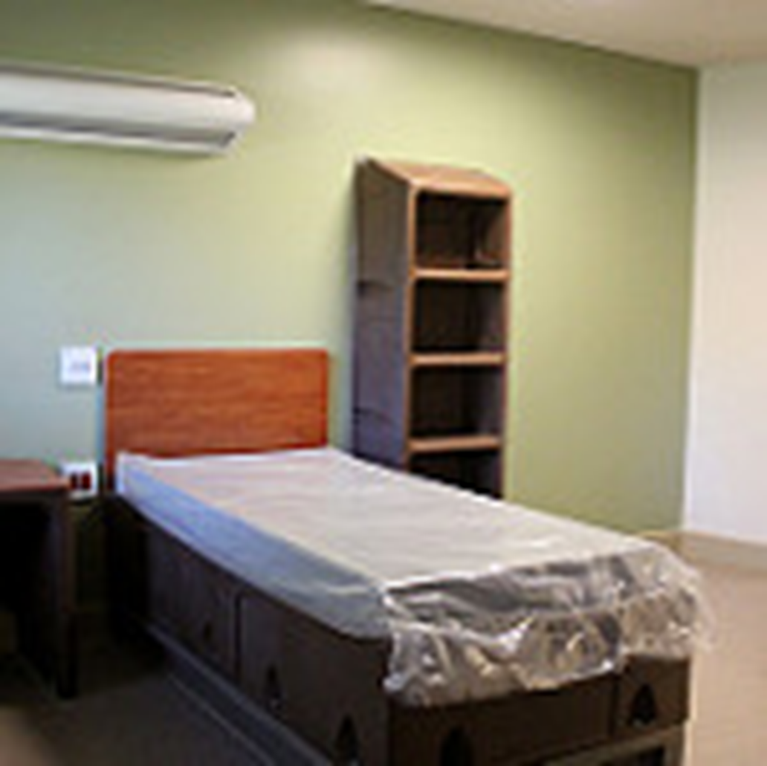
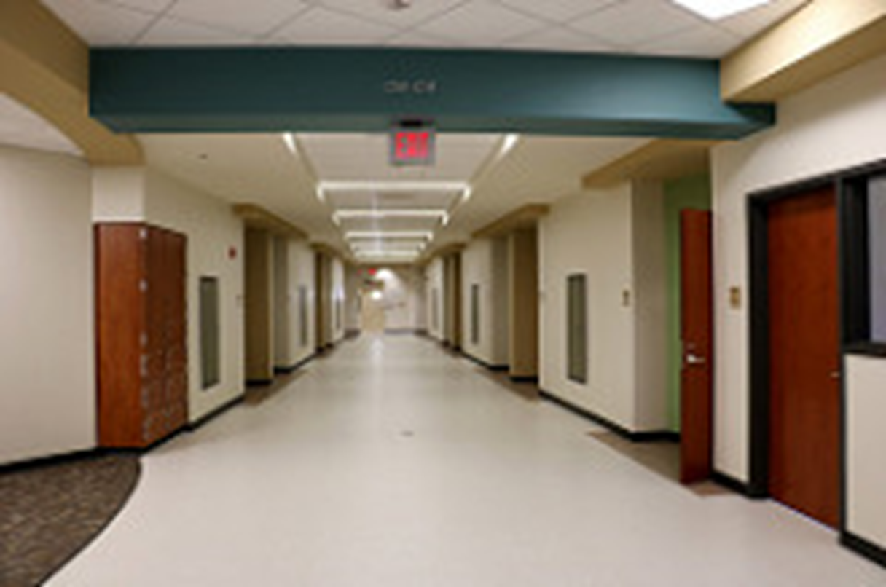
Northcoast Behavioral in Sagamore Hills
www.admboard.org
RECOVERY STARTS HERE.

Slide 38
Conditional Release/Forensic Monitor
41 state forensic monitors for conditionally-released NGRIs and ISTU-CJ
Balance individual treatment needs and community safety
Act as a “friend of the court”
Work with teams to produce a conditional release plan
Report local data to the state forensic office
Assist with competency cases
www.admboard.org
RECOVERY STARTS HERE.

Slide 39
Conditional Release Requirements
Common orders:
Medication compliance
24/7 supervised housing at discharge
No criminal activity or associations
No drugs, alcohol, or firearms in the home
No out-of-state travel
Suzanne Hopper Act Registry (Form 95)
Weekly visits with community rehabilitation specialist
www.admboard.org
RECOVERY STARTS HERE.

Slide 40
Form 95
Suzanne Hopper Act
Jan 1, 2011
Michael Ferryman: Moved from Morgan to Clark county.
Register everyone on conditional release (Form 95)
State forensic director collects data on “shared” clients
www.admboard.org
RECOVERY STARTS HERE.

Slide 41
Before the Hopper Act
In March 2010, Ferryman had stopped meeting monthly, as required, with his case worker and had no contact with him, Wilson said.
He moved to Clark County, and there was insufficient communication between the forensic monitors and mental health providers.
Blood tests after Ferryman died showed that he had not taken his prescribed medications for some time.
www.admboard.org
RECOVERY STARTS HERE.

Slide 42
Questions: Incompetency or NGRI?
www.admboard.org
RECOVERY STARTS HERE.

Slide 43
The Collyer Brothers: Homer and Langley
NYC
On March 21, 1947, police received a call about a terrible smell coming from the Collyer home.
Police arrived and dug for 5 hours, finding Homer’s dead body.
Floor to ceiling stuff
There was a massive manhunt for Langley, presumed killer
120 tons of stuff removed
April 8: Langley’s body found inside 2 ft wide tunnel, 10 ft from Homer
Langley died 2 weeks before Home.
www.admboard.org
RECOVERY STARTS HERE.

Slide 44
The Collyer Brothers: Back Story
Father, doctor. Both attended Columbia (law and engineering)
Both worked (lawyer and piano salesman)
Parents died six years apart.
Brothers remained in parents’ brownstone.
1932: Homer, stroke and blindness. Isolation began. Langley quit working.
Both refused doctors.
Homer’s diet: 100 oranges/week, black bread, and peanut butter
Utilities and water shut off
Langley began hoarding everything.
Booby traps inside the home killed Homer.
www.admboard.org
RECOVERY STARTS HERE.

Slide 45
Hoarding Disorder Criteria (DSM 5)
Difficulty parting with possessions, regardless of their actual value
Perceived need to save items and distress associated with discarding them
Hoarding results in the accumulation of possessions that congest and clutter active living areas and substantially compromises their intended use and potentially impacts safety
www.admboard.org
RECOVERY STARTS HERE.

Slide 46
Hoarding Disorder Criteria (DSM 5)
The hoarding causes clinically significant distress or impairment in social, occupational, or other important areas of functioning. Unsafe spaces.
Areas that may be affected include:
Getting to work
Socializing and maintaining friendships
Creating economic hardship because of needed renovations and cleanup costs
www.admboard.org
RECOVERY STARTS HERE.

Slide 47
Progression of Hoarding Disorder
By age 15, symptoms develop.
By 40, it is not problematic.
In the 60s-80s, needs clinical attention.
Trauma triggers behavior
Death of spouse
Injury
Hospitalization
Source: J. Grisham & M. Norberg in Dialogues in Clinical Neuroscience, Volume 12, 2010, Issue 2.
www.admboard.org
RECOVERY STARTS HERE.

Slide 48
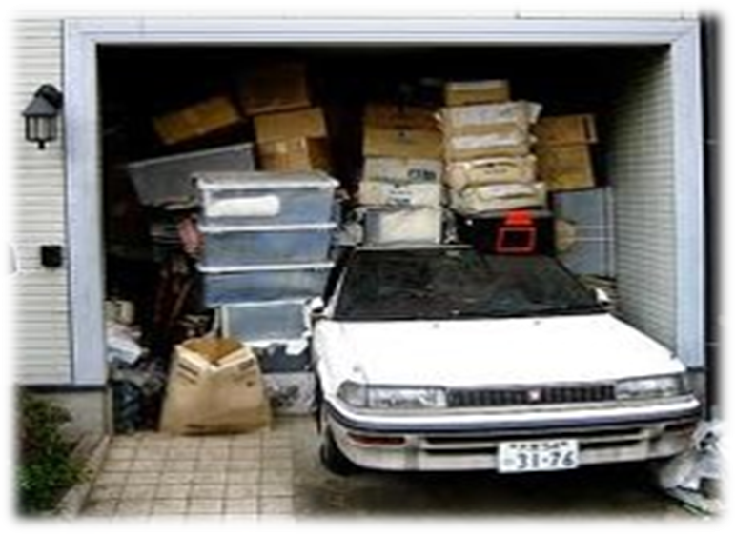
Unique Cognitive Processes
Individuals with Hoarding Disorder have:
Attention deficit, lack of focus
Decision-making is slowed by perfectionism
Co-occurring depression/anxiety (common)
Emotional distress with parting with objects
www.admboard.org
RECOVERY STARTS HERE.

Slide 49
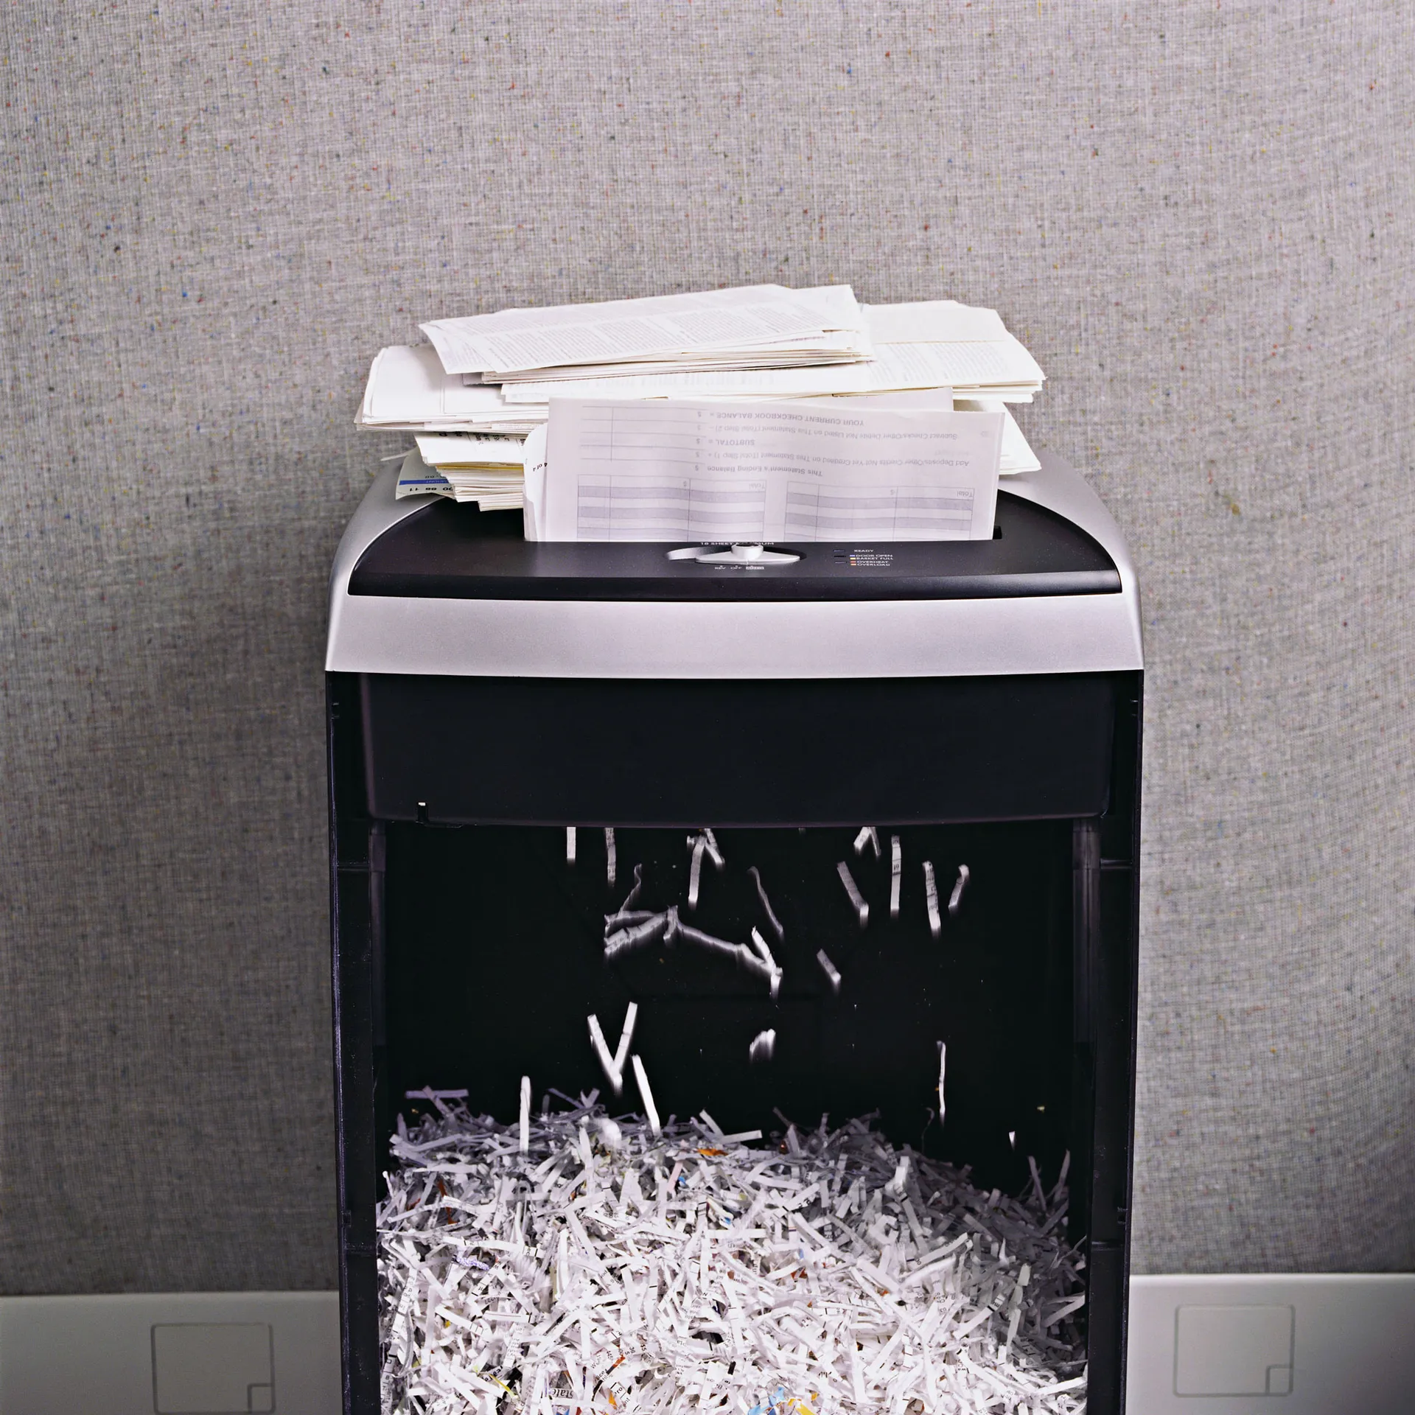
David Tolin Study
100 patients, 3 groups
Piles of junk mail
Functional MRI
Researcher with a shredder
Low brain activity when shown others’ items
High brain activity (insula) when shredding own items
www.admboard.org
RECOVERY STARTS HERE.

Slide 50
Psychological Contributors
Anxiety and depression (75%) complicates treatment.
Trouble with problem-solving abilities.
Often have unhelpful thoughts (e.g., “Why bother? I’ll never make progress,” and “It’s not really that bad.”).
Loss of personal property = loss of identity/security.
Trauma triggers hoarding.
www.admboard.org
RECOVERY STARTS HERE.

Slide 51
Signs
Piles of stuff!
Impaired pathways/stairways (“goat paths”)
Losing important items in clutter
Duplicate items
Rodent/insect infestation
Rotting food and/or used food containers
Non-working or non-functional appliances, utilities
Piles of “free” items (e.g., pens, notepads, cups, etc.) from community fairs or from “trash day”
Not inviting friends and family in because of shame or embarrassment
www.admboard.org
RECOVERY STARTS HERE.

Slide 52
Hoarding Disorder
Grossly Undertreated
Underreported
Secrecy, ambivalence, stigma, shame
Lack of trained mental health professionals!
Cleanup can be very costly and takes a long time
Up to 2 years and $10,000s
www.admboard.org
RECOVERY STARTS HERE.

Slide 53
Treatment Method: Motivational Interviewing
Non-confrontational approach
Helps the client connect their values and behaviors
Works with ambivalence
Increases client’s confidence in their ability to change
www.admboard.org
RECOVERY STARTS HERE.

Slide 54
Hoarding Resources
Hoarding Task Force
ADM Board, SCPH, and 25 stakeholders/agencies
Few public funds for significant hoarding cleanup
Counseling:
Coleman, Greenleaf, Portage Path Behavioral Health
Some cleanup assistance:
SCPH, Adult Protective Services, Blick Center
2nd Thursday, 8-9 am
www.admboard.org
RECOVERY STARTS HERE.

Slide 55
Questions?
www.admboard.org
RECOVERY STARTS HERE.

