Slide 1


The ADM Board’s System of Care and Client’s Rights
Dr. Doug Smith
Chief Clinical Officer, ADM Board
www.admboard.org
RECOVERY STARTS HERE.
May 13, 2025

Slide 2



Topics
The ADM Board’s System of Care
Client’s Rights
“Forensic” Cases
Hoarding Disorder
www.admboard.org
RECOVERY STARTS HERE.

Slide 3
Successful, long-term recovery is built on a foundation of hope.
Report to the Community, Summit County ADM Board
www.admboard.org
RECOVERY STARTS HERE.

Slide 4

Hopeful
www.admboard.org
RECOVERY STARTS HERE.

Slide 5
The ADM System of Care offers hope through timely access to treatment.
Report to the Community, Summit County ADM Board
www.admboard.org
RECOVERY STARTS HERE.

Slide 6
Timely Access
Past | Present
2013—Central Assessment: 50 days average from call to Substance Use Disorder (SUD) assessment | 2023—Decentralized assessment: Most common wait is one day.
No follow up system for opiate overdoses (e.g., overdose, hospital treatment, discharge, death) | Quick Response Teams (QRT)* follow up with team contact within a week, decreasing cycling and intervening when motivation is high; Naloxone distribution *Currently, only 5 QRT are active.
www.admboard.org
RECOVERY STARTS HERE.

Slide 7
Treatment…But Not Just Any Kind of Treatment
Evidence-based practices (EBP)
  Studied, scientifically validated
  Cost effective
  Participants and taxpayers
  Minimally invasive
    See Client’s Rights
www.admboard.org
RECOVERY STARTS HERE.

Slide 8
EBP Fidelity and Outcomes
Is the EBP being implemented in a way that it was designed by the researchers?
Are we getting the expected outcomes from implementation of the EBP?
Case Western Reserve Fidelity Reviews
www.admboard.org
RECOVERY STARTS HERE.

Slide 9
Evidence-Based Intervention Examples
CET: Cognitive Enhancement Therapy
CBT: Cognitive Behavior Therapy
Mental Health Courts
Drug Courts
Medication
www.admboard.org
RECOVERY STARTS HERE.

Slide 10
How does Summit County offer hope through timely access to treatment?
www.admboard.org
RECOVERY STARTS HERE.

Slide 11
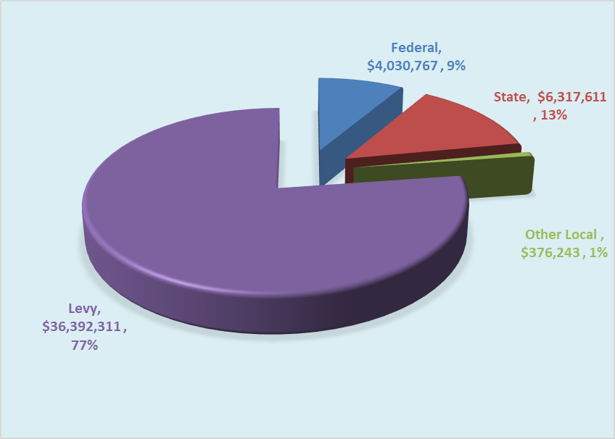
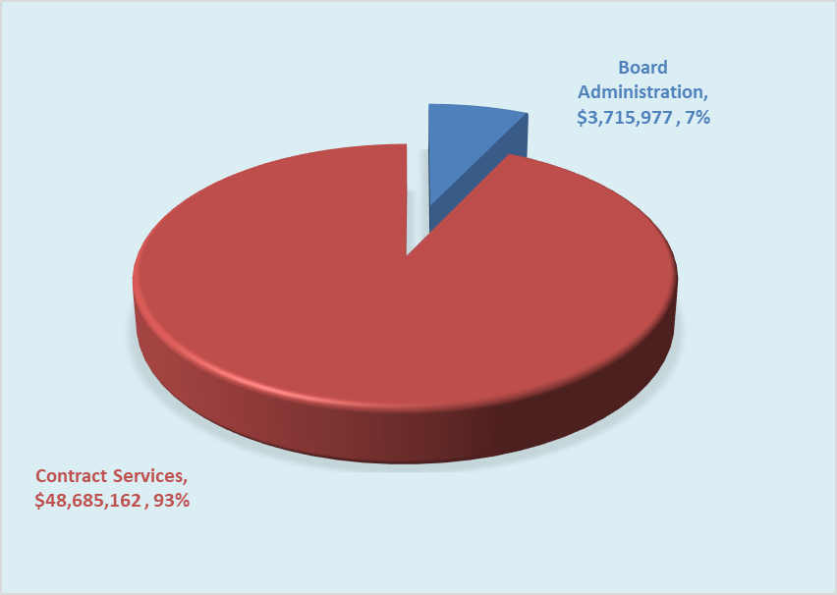
Financial Snapshot – Levy Passed 11/4/25 – Thanks!
2025 Revenue Outlook: $36.39M
2025 Expenditure Outlook: $52.4M
www.admboard.org
RECOVERY STARTS HERE.

Slide 12

Circle of Hope: Partner Agencies
Akron UMADAOP
Alliance for Healthy Youth
ARC Recovery Services
Asian Services in Action (ASIA)
Bellefaire JCB
Blick Center
Catholic Charities
Child Guidance and Family Solutions
CHC Addiction Services
CHOICES: A Community Learning Center
Coleman Health Services
Community Support Services
Freedom House for Women
Greenleaf Family Center
Hope United: Tyler’s Redemption
IBH Addiction Recovery
Legacy III
Minority Behavioral Health Group
OhioGuidestone
Oriana House
Portage Path Behavioral Health
Red Oak Behavioral Health
Summit County Community Partners
Summit County Juvenile Court
Summit County Public Health
Summit County Sheriff’s Office, D.A.R.E.
Shelter Care
Summit Psychological Associates
Summit Recovery Hub RCO
Tarry House
Truly Reaching You
Victim Assistance Program
Urban Ounce of Prevention Behavioral Health Services
www.admboard.org
RECOVERY STARTS HERE.

Slide 13
ADM and Public Health Collaboration
  Co-Location aids collaboration
  COVID
  QRT
  Harm Reduction: Narcan and Project DAWN
  Youth Risk Behavior Survey (YRBS)
  Community Health Assessment (CHA)
RECOVERY STARTS HERE.

Slide 14
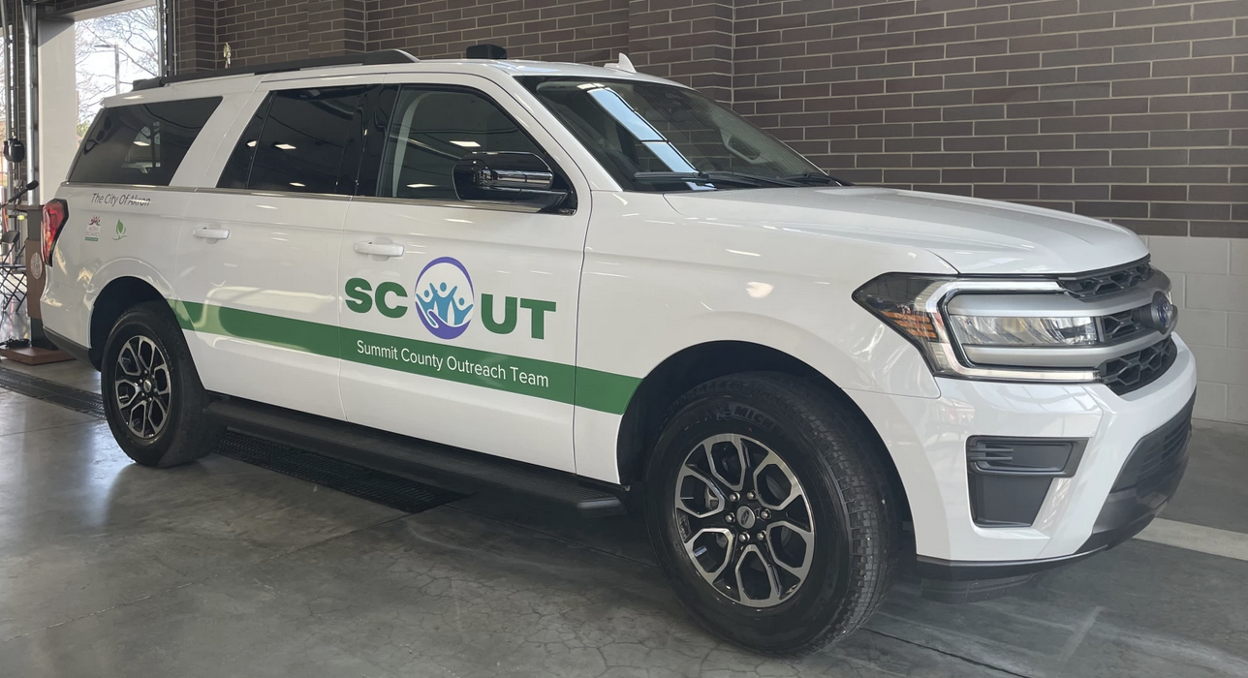
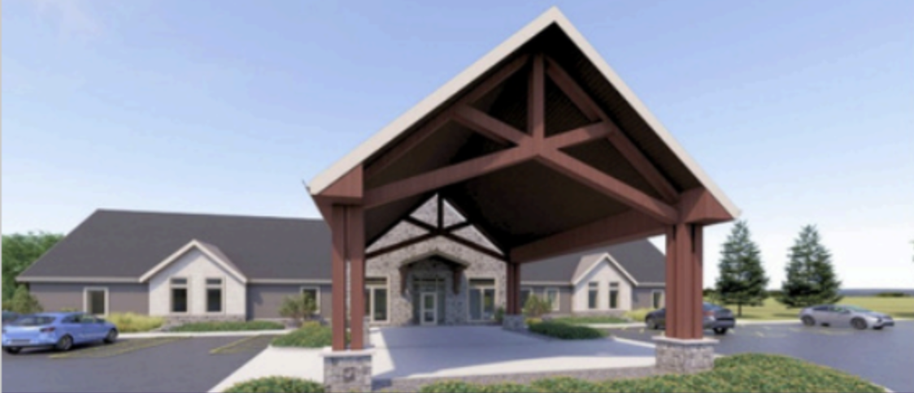
Collaborative Health Initiatives
  Crisis System Enhancement
    SCOUT mobile crisis team (Launched in 2024)
    Revisioning of the current ADM Crisis Center (e.g., pharmacy, community rooms, labs, etc.)
  Dr. Fred Frese Residential Center
    Post-hospital for 30 to 90 days
  Behavioral Health Partnership with University of Akron
    Focus on growing the behavioral health workforce pipeline
  Thrive House
    14 bed facility at 1445 Frederick Blvd
    Opened August 2024
    Partnership with Summit County Sheriff’s Office, County of Summit, ADM Board, Summit Psychological Services, and Summit Land Bank
RECOVERY STARTS HERE.

Slide 15
ADM Board Funds: Tarry House
16 bed residential treatment facility for SPMI
Group and individual recovery activities
Emphasis on daily living skills and social skills
Respite program for homeless individuals with mental health disorders who are at risk of hospitalization
Accepts discharge-ready patients who support to find living arrangements
www.admboard.org
RECOVERY STARTS HERE.

Slide 16
ADM Board Funds: CSS
Assertive Community Treatment
  3 ACT teams
  Case management
    4 regional teams; geriatric, forensic team
  Mental Health Court
    Akron, Barberton, Stow, Hope Court
  Homeless outreach
  Serious mental health and substance abuse
  Crisis and engagement team
        Supported employment and three 24/7 group homes
www.admboard.org
RECOVERY STARTS HERE.

Slide 17
ADM Board Funds: ASIA, Inc.
Started in 1995; largest in NE Ohio (currently)
Botvin LifeSkills, after school and summer
LifeSkills targets drug use, alcohol use, violence, and tobacco use
Language Education Program: bilingual mental health outreach to Bhutanese and Nepali population
www.admboard.org
RECOVERY STARTS HERE.

Slide 18
Questions: ADM Board’s System of Care?
www.admboard.org
RECOVERY STARTS HERE.

Slide 19
Client’s Rights (see OAC 5122-26-18)
Every individual is protected by a system of rights.
  “…treated with consideration, respect for personal dignity, autonomy and privacy.”
  “To be treated in the least restrictive, feasible environment”
www.admboard.org
RECOVERY STARTS HERE.

Slide 20
Examples of Client’s Rights (see OAC 5122-26-18)
Participation in treatment and planning; get a copy
The right to be “informed of one’s own condition”
The right to be informed of the reason for denial of services
The right to file a grievance
Confidentiality of communications and personal identifying information
Source: CSSbh.org
www.admboard.org
RECOVERY STARTS HERE.

Slide 21
ADM Board Contact
Holly Cundiff, Care Access/Client Rights Coordinator
Phone: 330-564-4087
Email: hcundiff@admboard.org
www.admboard.org
RECOVERY STARTS HERE.

Slide 22
Questions: Client’s Rights?
www.admboard.org
RECOVERY STARTS HERE.

Slide 23
Question
What do you call a defendant who is incapable of understanding the nature and objectives of the proceedings against him?
www.admboard.org
RECOVERY STARTS HERE.

Slide 24
ANSWER
Incompetent to stand trial: A defendant who is incapable of understanding the nature and objectives of the proceedings against the defendant OR of assisting in his defense.
www.admboard.org
RECOVERY STARTS HERE.

Slide 25
Question
What happens if a judge, attorney, or prosecutor raises the question of incompetency?
www.admboard.org
RECOVERY STARTS HERE.

Slide 26
Answer
The Court orders Psycho-Diagnostic clinic to complete a competency evaluation.
PDC has 30 days to complete the evaluation.
www.admboard.org
RECOVERY STARTS HERE.

Slide 27
Question
What happens if the defendant, as the result of the symptoms of a mental health disorder or another reason, does not cooperate with the competency examination?
www.admboard.org
RECOVERY STARTS HERE.

Slide 28
Answer
The court orders the defendant to Northcoast for up to 20 days to complete the competency evaluation.
www.admboard.org
RECOVERY STARTS HERE.

Slide 29
Court Findings
Incompetent to Stand Trial
The court orders the defendant to undergo competency restoration treatment at Northcoast (inpatient) or Summit Psychological Associates (outpatient)
www.admboard.org
RECOVERY STARTS HERE.

Slide 30
Restoration Treatment
Maximum Time
Felony 1 or 2, violent = 1 year
Felony 3, 4, or 5 = 6 months
Misdemeanor 1 or 2 = 60 days
All other misdemeanors = 30 days
www.admboard.org
RECOVERY STARTS HERE.

Slide 31
What if…
The defendant is not restored to competency?
Felony 1 or 2, violent: The court can maintain jurisdiction over the defendant for the longest period of time had the defendant been found guilty of the most serious crime. “ISTU-CJ”
Lesser charges? Dismissed. Probate?
www.admboard.org
RECOVERY STARTS HERE.

Slide 32
Ohio Revised Code “NGRI”
R.C.2901.01(A)(14): “A person is not guilty by reason of insanity…if the person proves…by a preponderance of the evidence, that at the time of the commission of the offense, the person did not know, as a result of a severe mental disease or defect, the wrongfulness of the person’s acts.”
www.admboard.org
RECOVERY STARTS HERE.

Slide 33
Not Guilty by Reason of Insanity/ISTU-CJ
47 NGRI or ISTU-CJ clients
Commitment length: 1 year to life
  Life (longest) n=13
  29 NC, Heartland, Twin Valley, Warrensville Dev Center,
  Columbus Developmental Center
  18 on conditional release (13 F1’s, 5 F 2’s) in Summit and
  Franklin Counties
    6 F1 SF murder/attempted murder/rape
    7 F1 Agg Arson, Agg Burglary, Agg Robbery, Assault
    5 F2 Agg Arson, Burglary, Fel Assault
www.admboard.org
RECOVERY STARTS HERE.

Slide 34
NGRI Clients
Defendants are often doing what they perceive to be “the right or necessary thing” or they or a loved one will be seriously harmed if they did not act.
NGRI acquitees often feel intense guilt about their crime once stabilized and “clear minded”/ baseline
The guilt/remorse may not be expressed in a “normal” fashion or easily understood.
www.admboard.org
RECOVERY STARTS HERE.

Slide 35
NGRI Finding
After the finding, commitment evaluation.
At commitment hearing, judge usually commits the person to Northcoast.
Patient works through 5 levels of movement.
After a series of evaluations by Northcoast and the PDClinic, Northcoast asks for conditional release.
In most cases, the court grants conditional release to a 24/7 CSS group home after trial visits.
www.admboard.org
RECOVERY STARTS HERE.

Slide 36
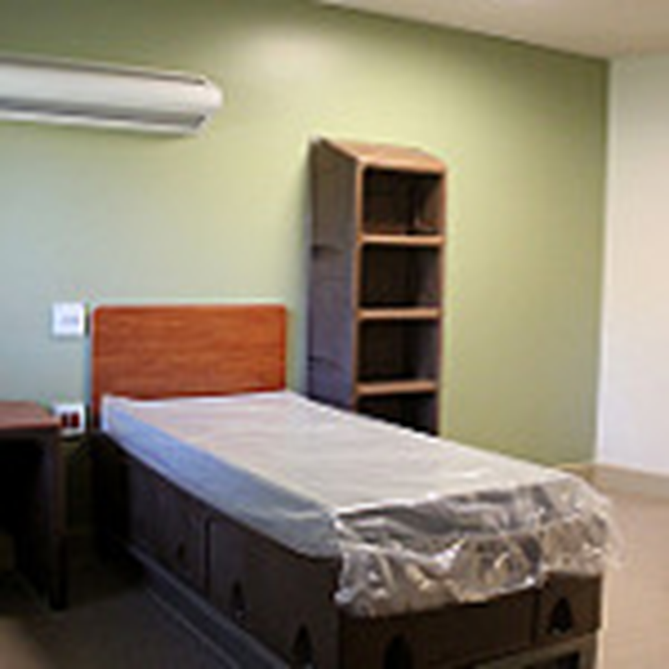
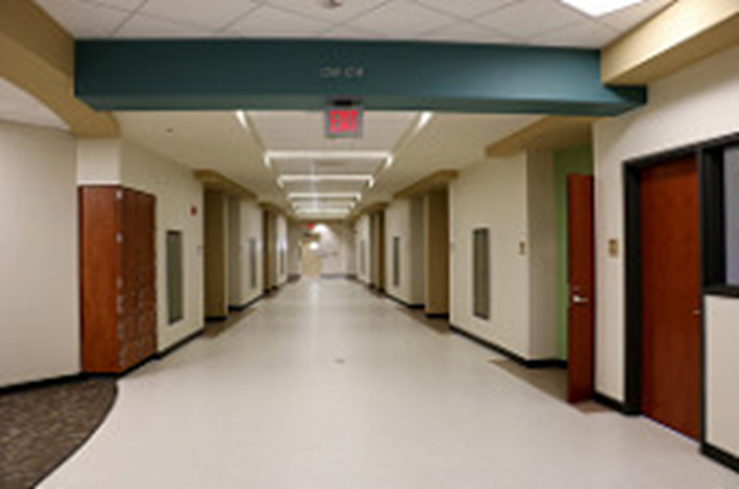
Northcoast Behavioral in Sagamore Hills
www.admboard.org
RECOVERY STARTS HERE.

Slide 37
Conditional Release/Forensic Monitor
38 Ohio Forensic Monitors monitor NGRI and ISTU-CJ persons under court jurisdiction in the community.
Task: Balance individual treatment needs and community safety
Act as a “friend of the court”
Work with teams to produce a conditional release plan
Report local data to the state forensic office
Assist with competency cases
www.admboard.org
RECOVERY STARTS HERE.

Slide 38
Conditional Release Requirements
Common orders:
  Medication compliance
  24/7 supervised housing at discharge
  No criminal activity or associations
  No drugs, alcohol, or firearms in the home
  No out-of-state travel
  Suzanne Hopper Act Registry (Form 95)
  Weekly visits with community rehabilitation specialist
www.admboard.org
RECOVERY STARTS HERE.

Slide 39
Before the Hopper Act
In March 2010, Morgan County, NGRI acquittee on conditional release, Michael Ferryman, stopped meeting monthly, as required, with his case worker and had no contact with him
Ferryman moved to Clark County, and there was insufficient communication between the forensic monitors and mental health providers.
Ferryman stopped taking anti-psychotic meds
www.admboard.org
RECOVERY STARTS HERE.

Slide 40

Form 95
Suzanne Hopper Act
  Jan 1, 2011
  Michael Ferryman: Moved from Morgan to Clark county.
  Register everyone on conditional release (Form 95)
  State forensic director collects data on “shared” clients
www.admboard.org
RECOVERY STARTS HERE.

Slide 41
Questions: Incompetency or NGRI?
www.admboard.org
RECOVERY STARTS HERE.

Slide 42
HOARDING DISORDER (HD)
www.admboard.org
RECOVERY STARTS HERE.

Slide 43
The Collyer Brothers: Back Story
Homer Lusk Collyer (1881-3/21/1947) and Langley Wakeman Collyer (1885-3/9/47)
Homer- Lawyer (Columbia); Langley –engineering/chemistry (Columbia) concert pianist
1919 parents separate; stayed w mother in Harlem brownstone
1923 father died, left lots of odd items
1929 Mother died, left all her items, brothers remained in home
1932: Homer, stroke and blindness. Isolation began. Langley quit working.
Both refused doctors. Rumors, burglaries, Langley booby traps.
Eccentricities: Homer’s diet: 100 oranges/week, black bread, and peanut butter
Utilities and water shut off
www.admboard.org
RECOVERY STARTS HERE.

Slide 44
The Collyer Brothers: Homer and Langley
NYC, Harlem
March 21, 1947: police call about a terrible odor coming from the Collyer home.
Police arrived and dug for 5 hours, finding Homer’s dead body.
Floor to ceiling stuff
There was a 5 state manhunt for Langley, presumed killer
www.admboard.org
RECOVERY STARTS HERE.

Slide 45
The Collyer Brothers: Homer and Langley
19 straight days of sorting through the house, searching for clues and searching for Langley
www.admboard.org
RECOVERY STARTS HERE.

Slide 46
The Collyer Brothers: Homer and Langley
140 tons of stuff removed
www.admboard.org
RECOVERY STARTS HERE.

Slide 47
The Collyer Brothers: Homer and Langley
April 8, 1947
Langley’s body found inside 2 ft wide tunnel, 10 ft from Homer
Langley died 2 weeks before Homer
www.admboard.org
RECOVERY STARTS HERE.

Slide 48
Hoarding Disorder Basics
You have encountered a lot of people with HD in your personal and professional lives, yet often didn’t know it
HD is a chronic but treatable mental health condition, separate from OCD
Like any mental disorder left undiagnosed and untreated for decades, outcomes can be poor or more complex than disorders that are treated earlier
Symptoms include
(1) Unusual emotional attachment to, and difficulty parting with possessions,
regardless of their actual value
(2) Significant anxiety/distress with discarding items
(3) Possessions congest/clutter causing safety issues or inability to use space as
intended
www.admboard.org
RECOVERY STARTS HERE.

Slide 49
Progression of Hoarding Disorder
By age 15, symptoms develop.
By 40, it is becoming more problematic
By 60s-80s, needs clinical attention.
Trauma triggers behavior
  Death of spouse
  Injury
  Hospitalization
  Source: J. Grisham & M. Norberg in Dialogues in Clinical Neuroscience, Volume 12, 2010, Issue 2.
www.admboard.org
RECOVERY STARTS HERE.

Slide 50
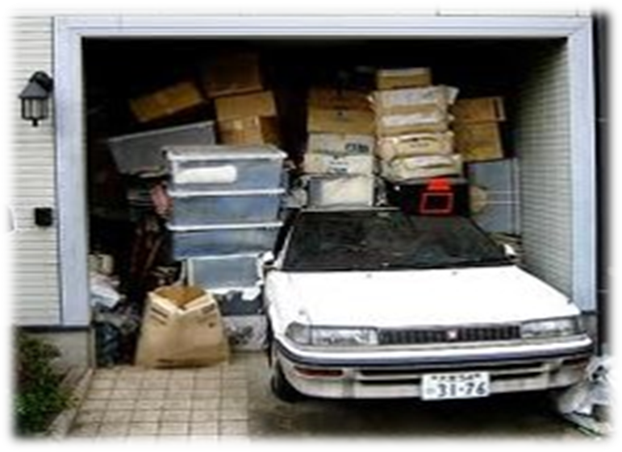
HD characteristics: Unique Cognitive Processes
Attention deficit, lack of focus
Decision-making, problem solving slowed by perfectionism
Co-occurring depression and/or anxiety common (75%)
Emotional distress with parting with objects
www.admboard.org
RECOVERY STARTS HERE.

Slide 51
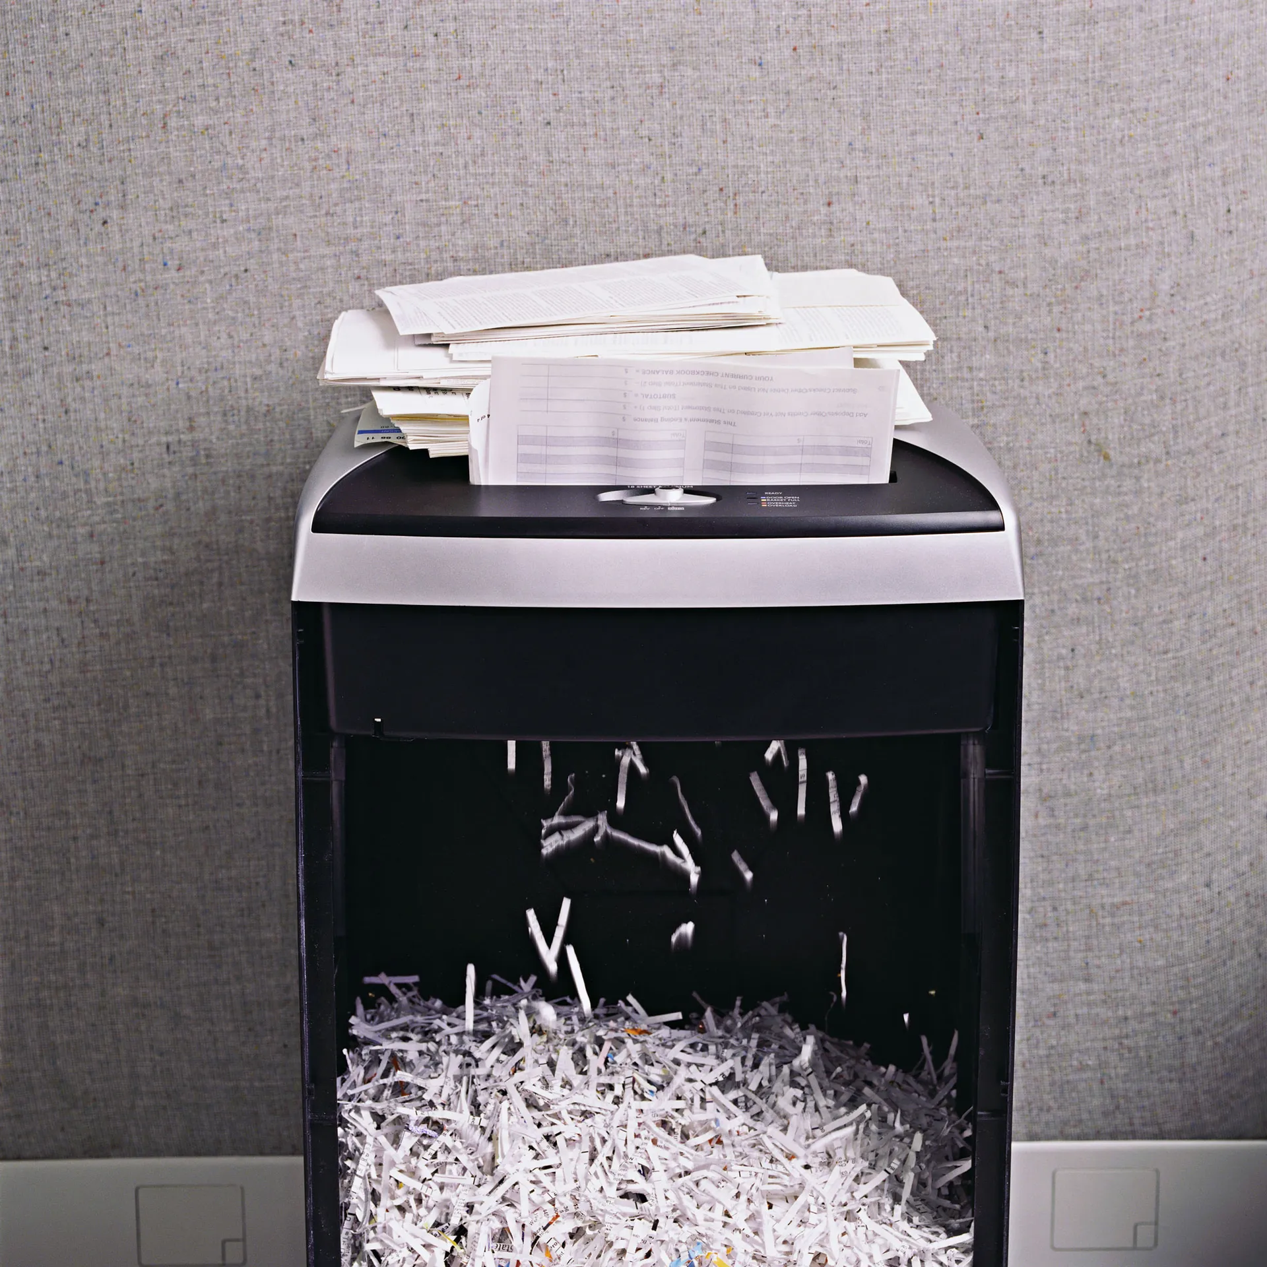
Dr. David Tolin Study, 2012
100 patients, 3 groups
Piles of worthless junk mail/magazines (participants and researchers)
Functional MRI (FMRI)
Researcher w a shredder: 1 question: “Should I keep or shred your (or my) item?”
Decreased brain activity when shown others’ items
High brain activity (insula and anterior singulate cortex) ) when considering shredding own items (decision making, attachment, reward, impulse control and emotional regulation)
www.admboard.org
RECOVERY STARTS HERE.

Slide 52
Psychological Contributors
Anxiety and depression (75%) complicates treatment.
Often have unhelpful thoughts (cognitive distortions) (e.g., “Why bother? I’ll never make progress,” and “It’s not really that bad.”).
Loss of personal property = loss of identity/security.
Trauma triggers hoarding.
Fear of forgetting the memory if the item is discarded
www.admboard.org
RECOVERY STARTS HERE.

Slide 53
Signs
Piles of stuff!
Impaired pathways/stairways (“goat paths”)
Losing important items in clutter
Duplicate items
Rodent/insect infestation
Rotting food and/or used food containers
Non-working or non-functional appliances, utilities
Piles of “free” items (e.g., pens, notepads, cups, etc.) from community fairs or from “trash day”
Not inviting friends and family in because of shame or embarrassment
www.admboard.org
RECOVERY STARTS HERE.

Slide 54
Hoarding Disorder
Grossly Undertreated
Underreported
  Secrecy, ambivalence, stigma, shame
Lack of trained mental health professionals!
Cleanup can be very costly and takes a long time
  Up to 2 years and $10,000s
www.admboard.org
RECOVERY STARTS HERE.

Slide 55

Treatment Method: Motivational Interviewing
Non-confrontational approach
Helps the client connect their values and behaviors
Works with ambivalence
Increases client’s confidence in their ability to change
www.admboard.org
RECOVERY STARTS HERE.

Slide 56
Hoarding Resources
Hoarding Task Force : 2nd Th morning SCPH, and 25 stakeholders/agencies
  Few public funds for significant hoarding cleanup
  Counseling:
  Coleman, Greenleaf, Portage Path Behavioral Health
  Some cleanup assistance:
    SCPH, Adult Protective Services, Blick Center, Vantage Aging
www.admboard.org
RECOVERY STARTS HERE.

Slide 57
Comments/Questions?
www.admboard.org
RECOVERY STARTS HERE.

