Slide 1

Safe Management and care of those in crisis

Slide 2

◻ Understand the characteristics of Autism
◻ Learn how to look for signs and symptoms
◻ Recognizing the need to be aware
◻ Safe handling and some tips on how to approach such people
◻ Determine between behavior patterns and
psychological crisis

Slide 3

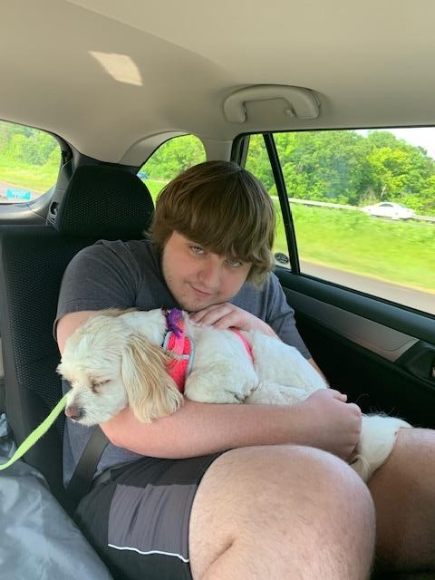
What does it look like?

Slide 4

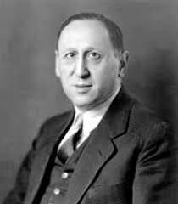
◻ First described autism in 1943
◻ “A powerful desire for aloneness”
◻ “An obsessive insistence on persistent sameness”

Slide 5

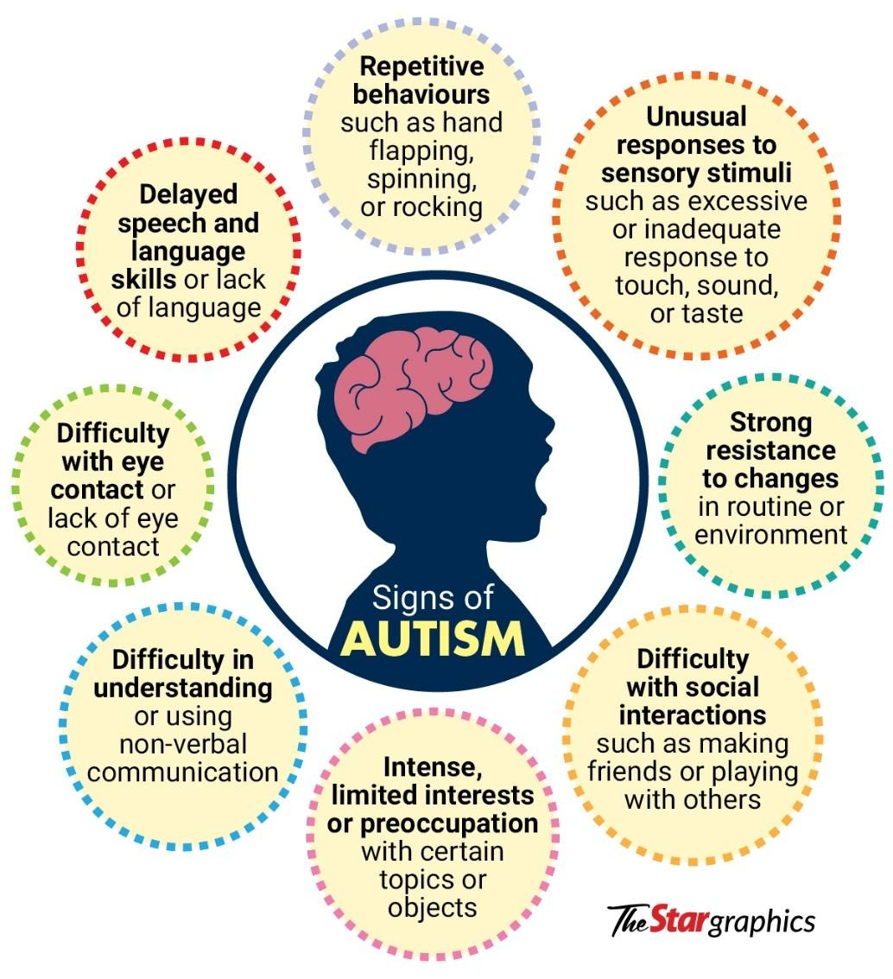

Slide 6

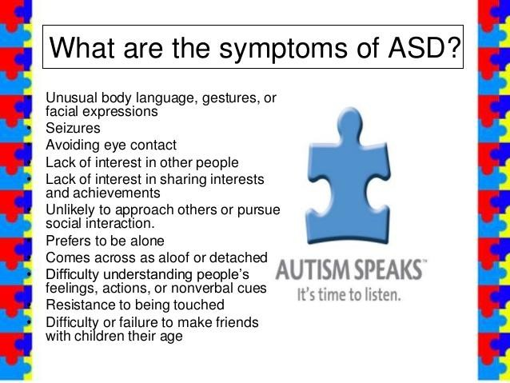

Slide 7

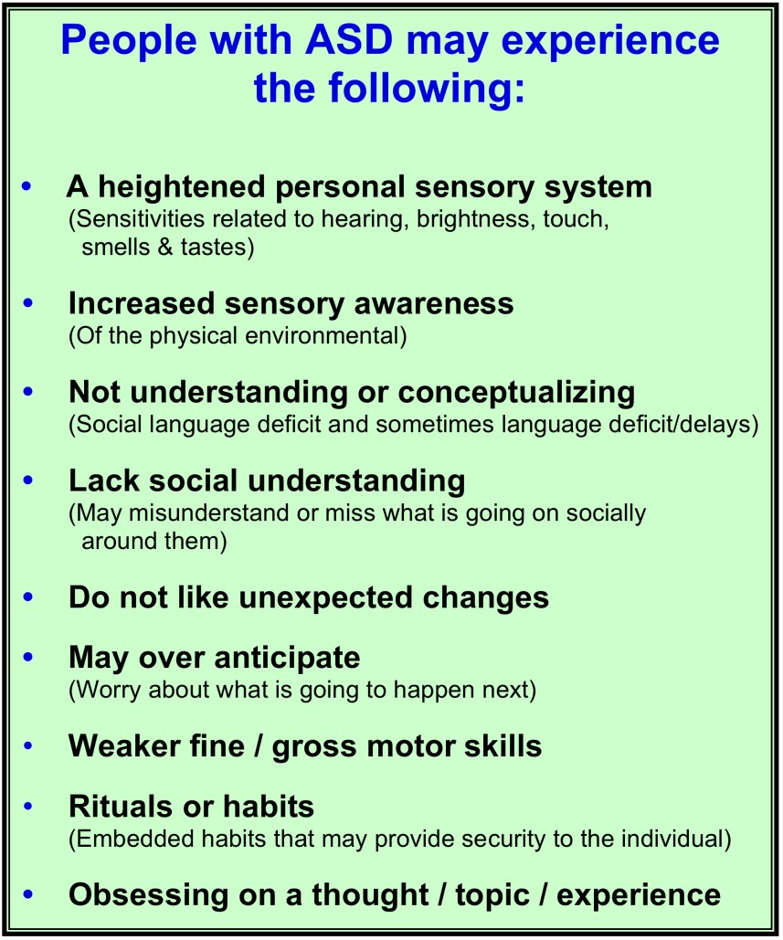

Slide 8

◻ Symptoms are manifested before age 22 and as early now as 18 months
◻ Must show limitations in at least 3 areas
◻ Self care
◻ Receptive and expressive language
◻ Mobility
◻ Self direction
◻ Capacity for independent living
◻ Economic self sufficiency

Slide 9

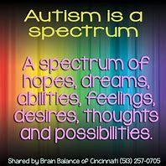

Slide 10

◻ Brain Architecture
◻ Chromosomal separation in utero
◻ Hormone imbalances
◻ Treatable in most cases

Slide 11
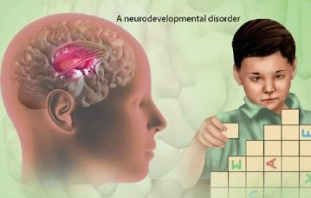

Slide 12

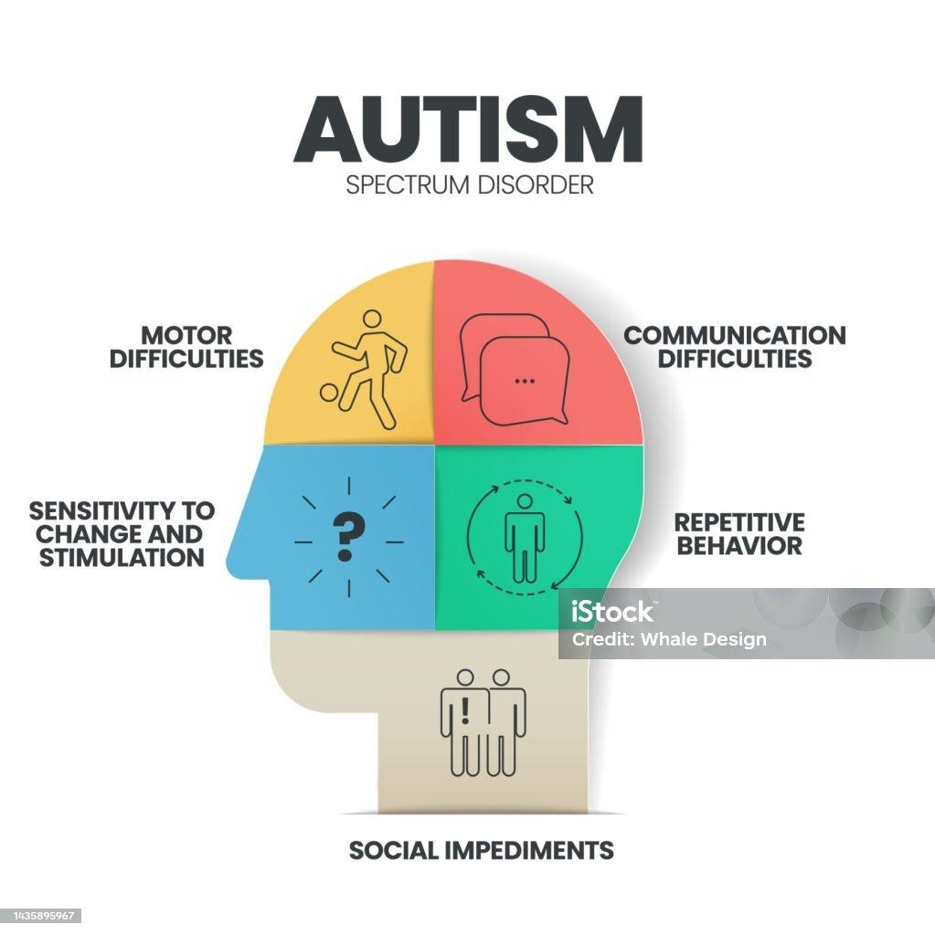

Slide 13

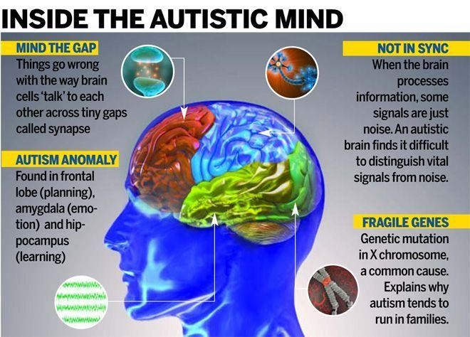

Slide 14


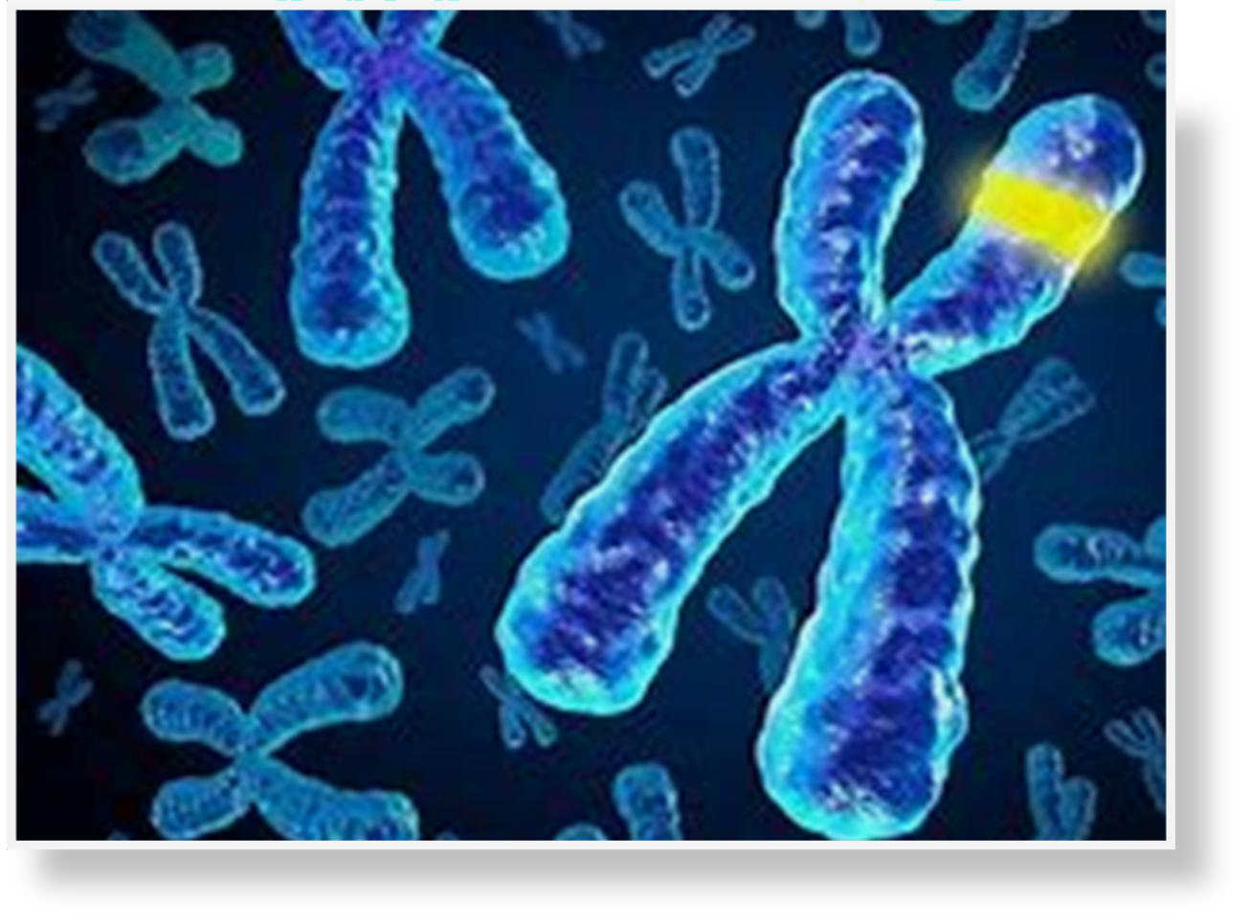
102 genes identified that if affected could lead to Autism

Slide 15

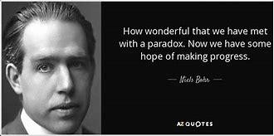

Slide 16

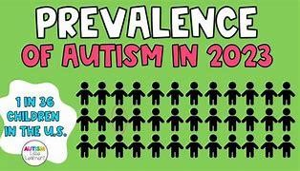
Is it more common now, or is the spectrum so wide that more people just fit in it now????

Slide 17

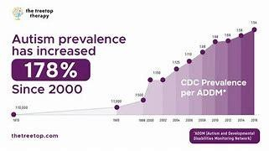

Slide 18

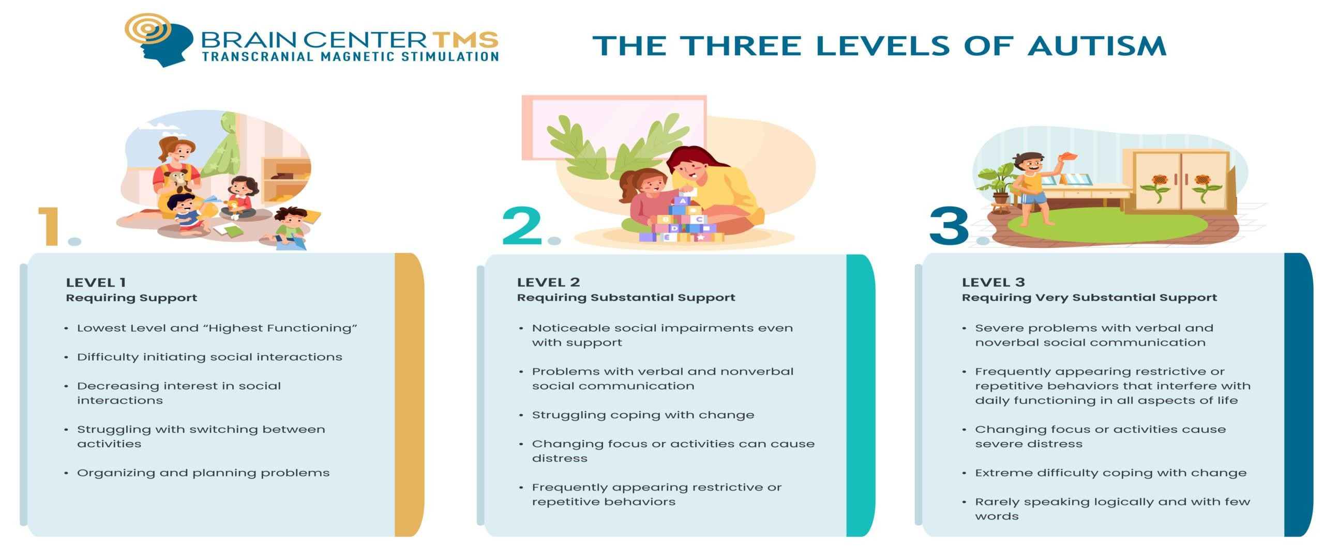

Slide 19

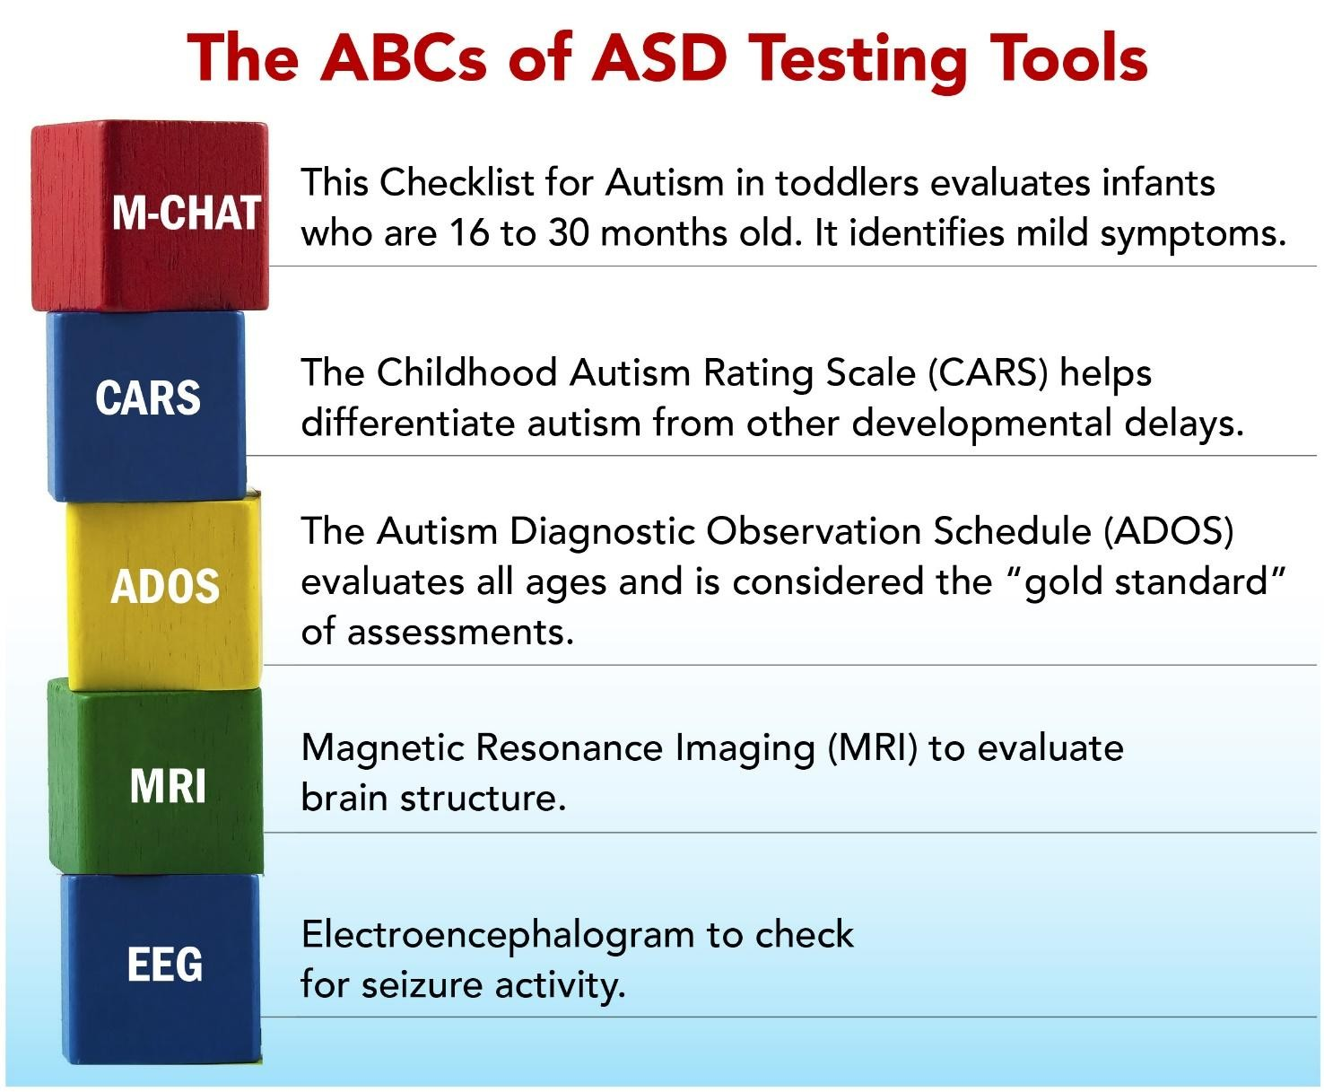

Slide 20

Lack of fear of real danger Sensory over stimulation Wandering and first contact issues Communication and behavior
De-escalation times increased Vulnerability/naive

Slide 21

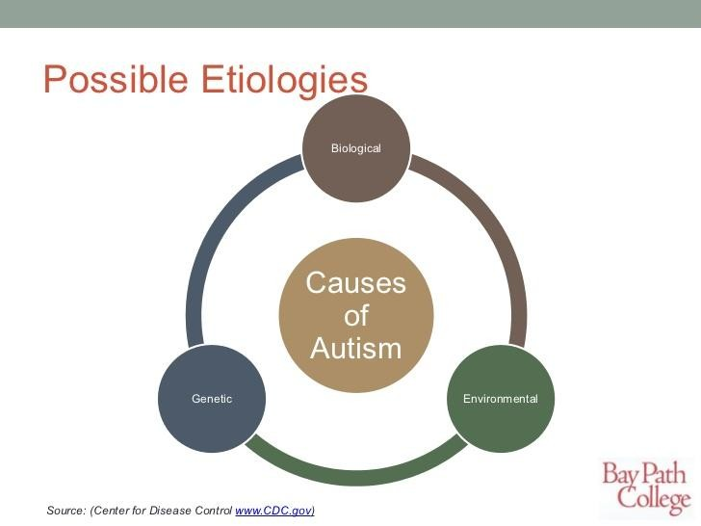

Slide 22
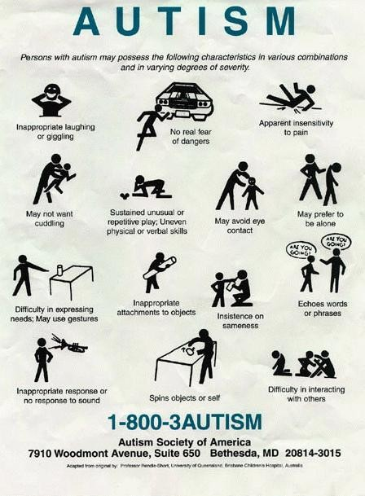

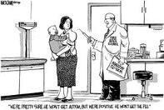
Causes
Genetic
Toxins
Viral Vaccines???

Slide 23

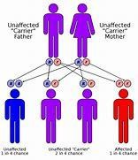
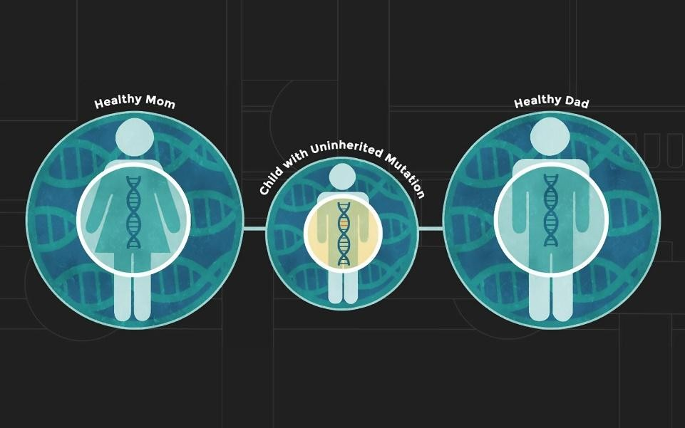

Slide 24

Currently there is no cure for ADHD or Autistic Spectrum disorders.
There are however treatments to decrease the severity of the symptoms

Slide 25

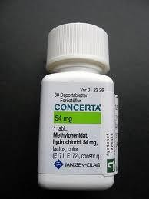
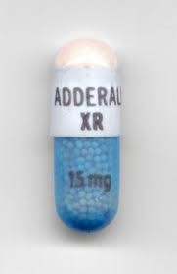
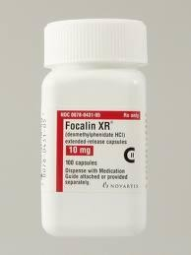
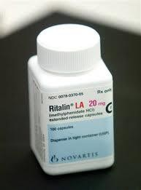
Meds
stimulants Focalin Adderall Concerta Cylert Ritalin
Non-stimulants
Strattera

Slide 26

DO
DON’T
◻ Overreact
◻ False promises
Use slang
◻ Be patient
◻ Honest/listen
◻ Give extra response
time
◻ Give choices
◻ Concise explanations
◻ Adult voice
◻ Have them repeat
Assume they are aware of danger
Avoid touch when possible Physical force
Repetition is not sign of
disrespect

Slide 27

Utilize parents knowledge
Ask about child’s quirks and sensitivities
Be concerned with child’s response to strangers Even older kids cannot express themselves very well
Frustration happens very quickly with these children
Pain tolerances on these children are usually very high. Lack of communication and complaints make it hard to
assess these kids

Slide 28

Remember, these kids do not get unknown diseases and illnesses, the key is to work around their developmental disorder and treat accordingly.
These kids are generally very much into structure and normal routines in their life. Any disruption can cause worsening of the situation.
Most of these kids on the high functioning end of the spectrum are extremely intelligent but lack certain social skills and the ability to interact effectively. Try to gain eye contact with the child.

Slide 29
◻ Many autistic people are prone to seizures
◻ Many display signs of depression, anxiety, obsessive compulsive disorder and bipolarism
◻ Although not common, some may have physical disabilities also.
◻ Tuberous sclerosis- benign tumors that form in the brain and other vital organs. 1-4%
◻ Fragile x syndrome- an inherited form of mental retardation approx. 5%

Slide 30

Remember:
Not every spectrum disorder person in crisis has been diagnosed.
Be aware of the signs
A big part of our jobs are to be able to read people without being judgmental.
Everyone in crisis deserves your complete attention.

Slide 31


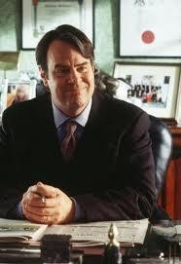
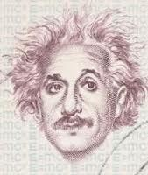
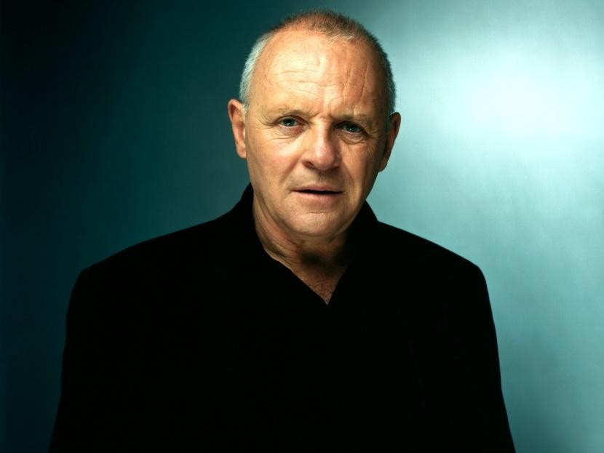


Slide 32

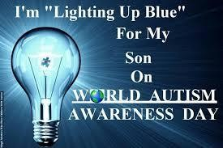

Slide 33


