Slide 1

Summit County Developmental Disabilities Board

Slide 2
Who are we?
Summit DD Board
SSA – Service and Support Administrator (case manager) assist with setting up services
Locations that you will get calls to –
shared living, apartment, congregate homes
It’s their home (pay rent)
Caregivers – parents, providers (24/7 supports or drop-in)
Notes:
Darann

Slide 3
Intellectual Disability
Definition: A person who has certain limitations in their mental capabilities that is diagnosed at birth/childhood
Intellectual disabilities affect an individual’s functioning level in two primary ways:
Intellectual Functioning = Includes things like reasoning, problem solving, judgment, and the ability to learn from past experiences
Adaptive Functioning = Includes things like self-care, language/communication skills, social judgment, money management
Autism – Video
Notes:
Darann

Slide 4

Spotlight on Autism
Video 1 - Sam (Autism)
Notes:
Darann - Sam is staying the night at Zahid’s but gets overwhelmed so he leaves and starts walking home.
How could have the officer responded differently?
What was Sam doing? - Stimming, Repeating
How did his friend re-direct him? Turn his chair,
Talk about different things
Say what they think - social cues

Slide 5
Autism and Law Enforcement:
What did you notice about Sam’s behavior?
What did his friend do to help him?
Here are some key things for officers to know about individuals with autism:
They may not look at you or respond in a timely manner. This means they may not respond when told to “stop.”
They may engage in what looks like unusual behaviors, including rocking, flapping hands, jumping up and down, etc. (stimming)
Some individuals with Autism may elope/wander and may be especially drawn to water.
They may have an impaired sense of danger (running out into the road)
They may not understand not to reach for your gun, badge, or other objects
Notes:
Darann

Slide 6
Individuals with Intense Needs:
Definition of Intense Needs:
Individuals with intense needs are typically characterized as:
having a dual-diagnosis – ID and Mental Health
having a complex trauma history
exhibiting significant behavioral issues
lacking service options
In order to successfully serve individuals with intensive needs, a multi-system approach is needed
.
Notes:
Darann

Slide 7
Trauma:
In addition to the presence of intellectual disabilities and mental illness, trauma is a key factor that plays into a person with intense needs.
What trauma do you see in your work everyday?
Notes:
Randall

Slide 8
Prevalence of Trauma:
70% of individuals with intellectual disabilities have been abused at least once in their lifetime, with 90% of those victims experiencing significant abuse on multiple occasions (Baladerian, Disability Awareness Project).
Individuals with a disability are four times as likely to be victims of a crime as the non-disabled population.
The best thing to do is to assume that most of the individuals you come across have experienced some type of trauma
Notes:
Randall

Slide 9
Examples of Trauma:
Some examples of potentially traumatic events:
Abuse: Sexual, physical, emotional, domestic violence in the home, bullying, etc.
Loss: Death, neglect, abandonment, war, etc.
Chronic Stressors: Poverty, racism, a family member with substance abuse, etc.
Notes:
Randall

Slide 10
Effects of Trauma:
What types of things does trauma do to people?
Trauma in the past effects how a person responds
Changes physiological responses (i.e. fight or flight)
May contribute to the behaviors - such as aggression, self-injury or sexual abuse to others
Notes:
Randall

Slide 11
Why do individuals have these responses/behaviors?
Environmental Factors (temperature, noise)
A means of communication (express pain)
Perception of being judged/disrespected
Changes in routine (lack of structure)
Attempt to gain control of a situation (power struggles)
A symptom of psychiatric illness
A way to avoid/escape unwanted demands
A means of getting staff/family’s attention
Staff Turnover
Notes:
Randall

Slide 12

How do you respond?
Trauma-informed
Reflect
Honor
Connect
Notes:
Darann
What can we learn from this video - wanders away from home like Sam in first video, Stimming, Scared - “I am ok”
Slow down, explain what you are doing

Slide 13
What To Do – Effective Strategies:
Attempt to create a positive, calm environment
Pay attention to your body language - 80-90% of communication is non-verbal
Address the individual by their name
Focus on ways to make the individual feel safe
Avoid side-conversations with another officer or family
Limit background noise when possible (turn off TV, music, cell phones)
Take a walk with the individual if they need to move to be in a better place to talk
Prior to meeting with the individual, get quick tips from staff/family about the person
Notes:
Randall

Slide 14
What To Do – Effective Strategies:
What to Say – Effective verbal skills for de-escalation:
Make the person feel heard: Ask open-ended questions and truly listen while the individual is talking
Focus on validating the individual’s feelings: How that person feels right now is the heart of the matter (Honor)
Paraphrase back what the person is saying to show understanding and create empathy with the individual (Reflect)
Avoid “why” questions: Asking a person things like “why did you do that” immediately makes the individual feel defensive (Instead Connect)
Notes:
Darann

Slide 15
What To Do – Effective Strategies:
What to Say – Effective verbal skills for de-escalation:
Keep your language simple and concrete: complex questions may increase an individual’s stress
Calmly/gently redirect the individual back to the topic at hand if they begin to rant about other topics
Consider carefully distracting the individual or changing the subject if he/she gets stuck on an upsetting topic for too long
Explain any transitions coming, or what will happen next
Set clear limits with the individual, and give her/him clear choices…Using a collaborative approach is ideal
Notes:
Randall

Slide 16
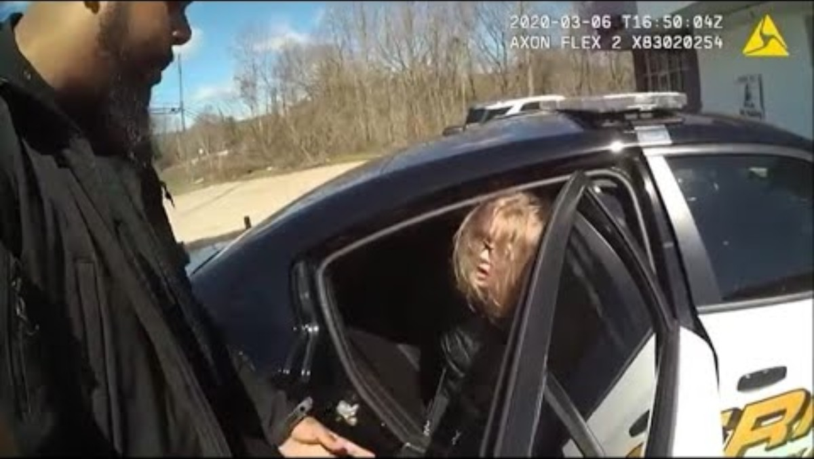
Video #3:
Video #3
Notes:
Randall
What are some of the positive things you saw from this video?
Experienced officer – slow down, talk to them

Slide 17
What Happens Next?
After you have de-escalated the situation and insured the safety of the scene, consider the following options:
If you continue to go out to the same home – contact partnering agencies (DD Board or Mental Health Board)
If the individual is having a psychiatric episode, assess the need for them to be taken to the ER.
If the individual has committed a crime, press charges! Do not feel the need to protect individuals from natural consequences for their actions, just because they have a disability. The court has well-paid experts to determine competency, so you don’t have to!
Notes:
Randall

Slide 18
Get them connected!
Anyone can make a referral for Summit DD services
Call us
www.summitdd.org
https://www.summitdd.org/contact-us/
Notes:
Darann

Slide 19

Success Story
Collaboration with Police
Training
- Follow-up
Notes:
Darann

Slide 20
Resources
Blue Envelope Program - Summit DD distributing envelopes
Reduces anxiety for concerned drivers/family
Provides important information to law enforcement
Improves communication during traffic stops/emergencies
Packet includes:
Blue envelope to keep important documents
Car Decal – tell officer someone in car as a disability
Wallet Card – carry with you to provide information quickly in emergencies
Program Brochure – explains how to use items in envelope
Enroll in LEADS database:
House Bill 144 Keith’s Law Disability Verification Form
Notes:
Darann

Slide 21
Thank You!
Darann Riley
Director SSA
330-962-6235
driley@summitdd.org
Randall Huber
Investigative Agent
rhuber@summitdd.org

