Slide 1


Summit County MRSS
Mobile Response Stabilization Services
Coleman Health Services
Megan Petruzzi Director of MRSS
330-379-0667 ext 1178
Megan.petruzzi@colemanservices.org

Slide 2

What is MRSS?
Families of children experiencing a behavioral health crisis often feel they have limited options to manage the crises and turn to the police or emergency rooms. MRSS provides the family with quick, effective clinical care in the least disruptive setting possible.
Mobile Response and Stabilization Services (MRSS) is a mobile outreach and stabilization service for children, young adults (up to age 21),experiencing a mental or behavioral health crisis. Our mobile response team will respond to the youth and family Monday through Friday from 8am to 8pm to their home, school, or any other community setting.

Slide 3
How Does MRSS Work?
All it takes to initiate MRSS is a phone call to the mental health crisis line 988, which operates 24 hours a day, 7 days a week, holidays included. Our local Summit County direct line is 330-564-4520
When you call 988, a crisis worker will work with you to collaborate on how to best respond to the youth and family’s needs. This includes dispatching the Mobile Response Team to an agreed upon location as soon as possible or, if needed, arranging for other emergency services.

Slide 4
What is the Goal of the MRSS Team?
The goals of a Mobile Response Team visit are to:
Establish individual and family safety
Maintain the youth in the least restrictive setting
Divert children from unnecessary hospital emergency rooms and inpatient hospitalization
Decrease use of arrests in school or in the community
Assist youth and families in learning new skills and building supports to reduce the frequency and intensity of future crises
Stabilize family needs through linkage and connection with ongoing services and supportive needs

Slide 5

What are the 3 stages of MRSS?
The services can be provided up to 6 weeks (42 days). The program consists of three stages:
  Screening and Triage- Information will be gathered about the crisis and the MRSS team will be deployed to a mutually agreed upon location or, if needed, arranging for other emergency services.
  Mobile- Response-The first meeting will occur within an hour or within 48 hours of receiving the call. Focus will be on de-escalation and safety planning. CANS assessment is completed within 72 hours. Additional needs assessments and supports for the mobile response will occur for 72 hours after receiving the referral.
  Stabilization-Children and families will stay connected with the MRSS team for up to 42 days to develop coping skills, work on effective communication within the family and restore structure and calm to the home. The stabilization period will end after a warm hand off to ongoing services is completed.
Fostering recovery, building independence, and changing destinies

Slide 6
Who Is on the Mobile Response Team?
MRSS Teams are made up of professionals who have expertise in treating the behavioral health needs of youth and young adults. Team members may include:
Licensed Clinicians
Case Managers
Family or Youth Certified Peer Support Specialists
Summit County team is currently made up of 3 licensed therapists, two case managers.

Slide 7

When Should I Call the Mobile Response Team?
Call 988 or 330-564-4520 when a youth or family is feeling emotional or in behavioral distress, such as:
Depression and Anxiety
Anger and Aggression
Self-Harm / Self Injury or Thoughts of Suicide
Substance Use
School Truancy
Family Conflict
Overwhelming Stress
Discharge from Hospital Stay
Change in Placement
Court or CPS Involvement
Remember the family defines the crisis!
Fostering recovery, building independence, and changing destinies

Slide 8

Who Can Call the Mobile Response Team?
Any community member who is concerned about a youth may call MRSS to make a referral and families may call us directly. MRSS is a voluntary service. It may be helpful to talk with the family about the referral prior to making it or assist them with calling. We do require the parent/guardian's consent to provide services. If they decline, we may not be able to respond.
Fostering recovery, building independence, and changing destinies

Slide 9
What to Expect
  Crises are defined by youth and families, and individualized plans are prepared for the youth and families specific needs.
  Our goal is to understand a family identified crisis, assess and keep children safe in the community without utilizing high cost and traumatic environments such as hospitals or residential treatment if possible
  Families can re-engage with MRSS as needed
  No cost to families
  Clients can continue to receive established community mental health services while involved with MRSS (limitations of moving into stabilization when involved with intensive homebased programs such as IHBT)
  MRSS is a home/community-based program. MRSS is often provided in homes, schools, community settings, and emergency rooms.

Slide 10

When will MRSS involve Law Enforcement?
If during triage, it is determined it may be unsafe to respond to alone​
If a crisis situation escalated after the MRSS team responded and it then became unsafe​
Additional situations determined by MRSS supervisor consultation
Fostering recovery, building independence, and changing destinies

Slide 11
What families are saying they found helpful about MRSS
• Every single thing they did helped tremendously, everything. I can’t even choose one.
• Helpful to have extra support
• How convenient it was. I loved that they were able to come to the home and they were very quick.
• How quickly they responded. Not only in person, but to get us connected with other places, so I guess the speed of everything was extremely helpful.
• The quickness of response for the first appointment.
• They came out right away, they were willing to sit with my child in her state of mind. The they gave me some referrals that we connected.
• They came right away, came to home, were able to get daughter stabilized, they offered resources that worked with our insurance.
• I would say just having someone to listen was probably the most helpful. Yeah, like somebody who understood what we were going through.
• I would think the resources that they had and the safety plan.
• Just having a listening ear. And having them talk with my son and in a way that he understood, and he could express himself helped a lot.
• Just having the resources and being there quickly and helping my child with just coping skills and things like that.
• Just that the staff was very personable, interactive, friendly and understanding.

Slide 12
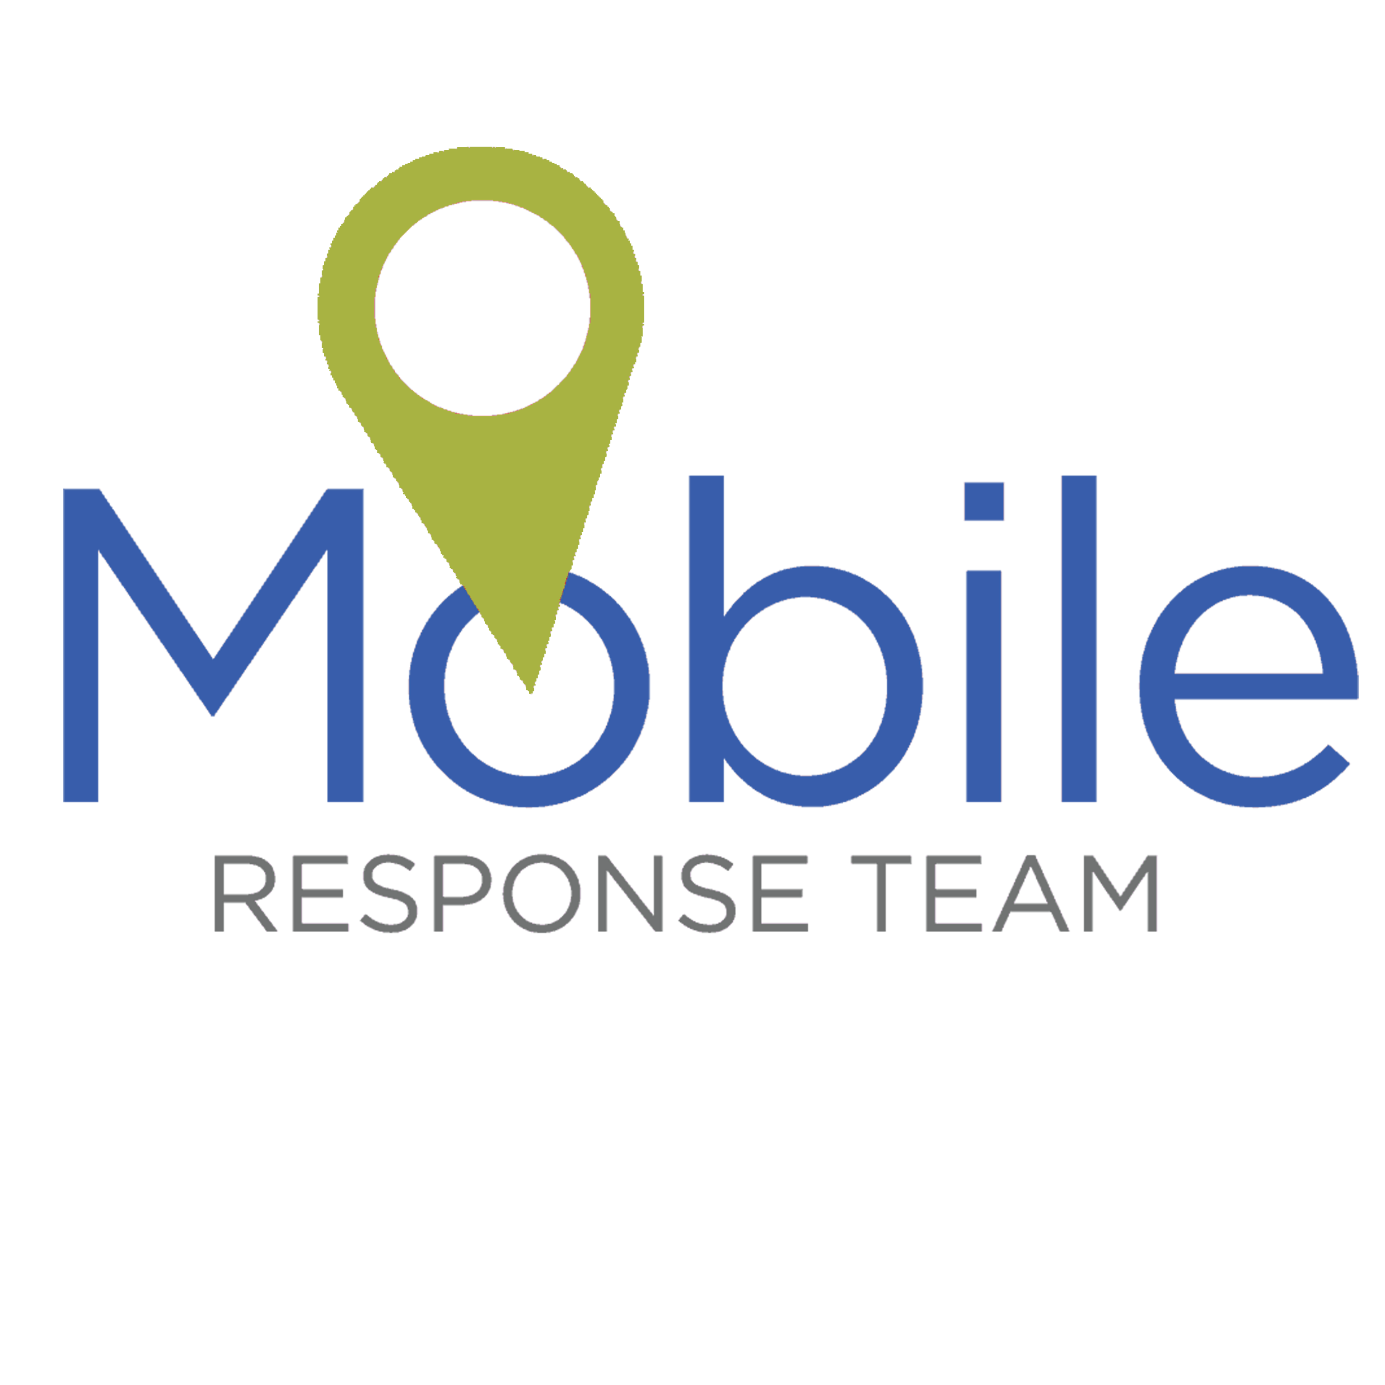
How do you access MRSS?
Dial
330-564-4520 or 988

Slide 13
THANK YOU!!
QUESTIONS?
Fostering recovery, building independence, and changing destinies

