Slide 1
Mental Illness in the Elderly - Dementia?
Eileen M. Schwartz, MD
Community Support Services
an affiliated agency of the
County of Summit
Alcohol, Drug Addiction and Mental Health Services Board

Slide 2

All older adults develop dementia eventually?
True
False
10
Countdown

Slide 3
Older adults don’t have schizophrenia…
True
False
10
Countdown

Slide 4
Thyroid disease can appear as a symptom of mental illness?
True
False
10
Countdown

Slide 5
Statistics
Lengthening of average life span
47 years in 1900, 75 years in mid-1990s
Almost 20% of the greater than fifty age group experience specific mental disorders not part of normal aging
Unrecognized or untreated mental illness can be severely impairing or even fatal

Slide 6
Culture of the Older Adult
WWI, WWII
Depression years
No technology
No abuse prevention
Family dynamics
Prejudices

Slide 7
Mental Illness in the older adult
Illnesses starting at an early age
Schizophrenia
Bipolar disorder
Personality disorders
Depressive disorders

Slide 8
Mental Illness in the older adult
Specific to Older Adults- Usually
Dementia
Delirium
Geriatric Depression

Slide 9
Why Are Older Adults So Challenging?
They don't like psychiatrists
They don't communicate well
Memory impairment
Aphasia
Unaware of emotional health
They have long histories to review

Slide 10
What makes them so Challenging?
Biologic Issues
Slowed down metabolism
Laboratory abnormalities
Multiple medications-
Drug/drug interactions
Sensory deficits
Visual loss
Hearing impairment

Slide 11
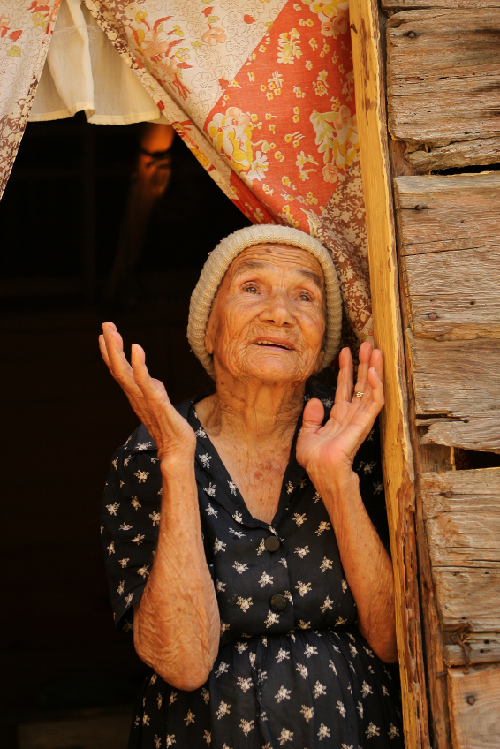
What makes older adults different?
Phase of life Issues-
Reminiscing
Grieving
Putting in order
Accepting fate
Increased spirituality

Slide 12
What Makes Older Adults Unique?
Multiple Losses
Family and Friends
Independence/
Autonomy
Possessions
Bodily functions
Privacy

Slide 13
Definition of Dementia
Slow, gradual loss of mental abilities
Changes in --
Memory
Personality
Behavior
Thinking Abilities

Slide 14
Definition of Dementia
Alzheimer’s disease is a type of dementia
There are many types of dementia caused by different conditions
Dementia is not a normal part of aging

Slide 15
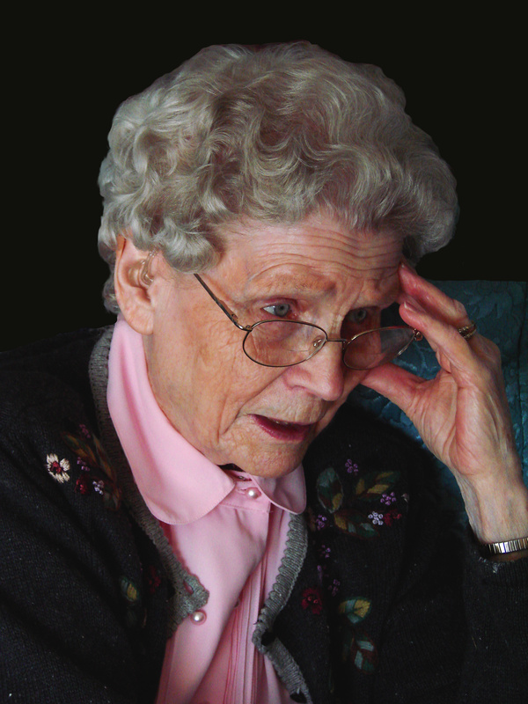
Memory Complaints
50-80% of older adults complain of memory problems
These complaints are usually a product of depression

Slide 16

Memory and Aging
Greater loss
recall > recognition capabilities
Slowing in:
information processing
selective attention
problem-solving ability
Vocabulary: increases until the mid 70s, after which it decreases

Slide 17
Alzheimer’s Disease
Strikes 8-15% of people over the age of 65, 43% of those over 85 years
Gradual, yet relentless, attack on memory
Other cognitive deficits
language
object recognition
executive functioning
Personality change

Slide 18
Alzheimer’s Disease
Behavioral symptoms- impose strain on caregivers
Direct and Indirect costs estimated at $203 billion each year

Slide 19
Who is at risk ?
People over the age of 65
Men > Women
Less educated > More educated

Slide 20
Causes of dementia
Irreversible conditions
stroke
Parkinson’s disease
Alzheimer’s disease
AIDS
rare viruses
certain inherited diseases

Slide 21
Causes of dementia
Reversible causes
thyroid problems
alcoholism
poor nutrition
emotional problems
reactions to medications
other problems - head injury, certain infections, increased pressure on brain, tumors, syphilis

Slide 22
What are signs of dementia ?
Forgetfulness - person may not remember
names
dates
events
directions
appointments
location of household objects

Slide 23
What are signs of dementia ?
Confusion
may not be able to follow directions
may not be able to learn new skills
judgment and reasoning may be poor

Slide 24
What are signs of dementia ?
May no longer be able to:
dress
prepare food
wash or bathe
manage money
communicate

Slide 25
What are signs of dementia ?
withdrawal
low energy
hostile feelings
loss of interest
mistrust of others
Misinterpreting -
actions or words of others
who people are
environment

Slide 26
What are signs of dementia ?
Difficult behaviors
wandering
resisting help
agitation
incontinence
inappropriate sexual behaviors
suspiciousness or paranoia

Slide 27
Evaluation of Dementia
Family background
Medical history
Lab tests
Psychiatric evaluation
Oral and written tests

Slide 28
Treatments
Treat underlying condition
medication
change in prescription
professional counselling
nutritional program
treatment of alcoholism or drug dependence
better social networking
surgery

Slide 29
Treatments
For irreversible dementia
medications - sleep, depression, agitation
daily lists
orderly arrangement of surroundings
daily exercise and proper diet
recreational therapy

Slide 30
Treatments
Treat the symptoms
Psychosis - paranoia
Depression with or without anxiety
Restlessness
Mood lability
Delay the decline

Slide 31
Delay the decline
Slow the curve of decline
Change time course
Prolong needed time for nursing home placement
The earlier the start of treatment, the better
Improvement in Memory usually not seen
May be improvement in self care abilities and behavioral disturbances

Slide 32
Medications specific to Dementia
Aricept
Exelon
Namenda
Companies trying various applications/forms
Pill
Dissolving tablet
Patch
Long acting

Slide 33
Care for the Caregiver
Support groups
Mental health care
Adult day care programs
Home health agencies
Long-term care facilities
Respite
Hospice personnel

Slide 34
What can you do?
Recognize the illness
Get to medical help as needed
Acknowledge the needs of the person (privacy, respect)
Be patient
Simplify requests
Do not overreact or confront

Slide 35

Medical Illnesses that mimic psychiatric conditions

Slide 36
Acute Mental Status Change
Disturbance of consciousness
reduced awareness of environment
reduced ability to focus
reduced ability to sustain or shift attention

Slide 37
Definition of Delirium
Change in cognition
memory deficit (mostly recent)
disorientation (mostly to time or place)
language disturbance (impaired naming, possibly aphasia)
development of perceptual disturbances (mostly visual)

Slide 38
Definition of Delirium
Disturbance develops over a short period of time
usually hours to days
Presentation fluctuates during the course of the day

Slide 39

Associated Features
Disturbance of sleep
daytime sleepiness, night time agitation, poor sleep continuity
Disturbance of psychomotor activity
hyperactive - agitated, psychotic
hypoactive - lethargic, confused
mixed

Slide 40
Associated Features
Emotional disturbances
anxiety, fear, depression, irritability, anger, euphoria, apathy
affective lability - rapid shifts, unpredictable

Slide 41
Associated Features
Nonspecific neurological abnormalities (depending on etiology)
Ex. Nystagmus and ataxia from medication intoxication
Cerebellar signs, myoclonus, generalized hyperreflexia may be seen from lithium toxicity
background slowing on EEG

Slide 42
Differential Diagnosis
Dementia vs. Delirium or
delirium superimposed on dementia
differences noted in disturbed consciousness or arousal
differences noted in fluctuating course
need for collateral information

Slide 43
Underlying Condition Assoc. with Delirium
Metabolic
renal or hepatic failure
anemia
hypoxia
hypoglycemia
thiamine deficiency
Endocrinopathy
fluid or electrolyte imbalance

Slide 44
Underlying Condition Associated with Delirium
Cardiopulmonary disorder
myocardial infarction
congestive heart failure
cardiac arrhythmia
shock
respiratory failure
Notes:
44

Slide 45
Underlying Condition Associated with Delirium
Systemic illness
substance intoxication or withdrawal
infection
neoplasm
sensory deprivation
temperature dysregulation
postoperative state

Slide 46
Medical Conditions
Hypothyroidism - depression
Hyperthyroidism - mania
Hyperglycemia - mania, agitation
Metabolic disturbances - psychosis, agitation (delirium)

Slide 47
Primary psychiatric condition?
Alcohol withdrawal - anxiety attacks
Alcohol, drug intoxication - psychosis
Head injury - dementia, psychosis

Slide 48
Service Delivery
Treatment of mental illness in the community can prevent institutionalization
Untreated mental illness can turn a minor medical problem into a life-threatening and costly condition

Slide 49
Delirium occurs only in older adults.
True
False

Slide 50
Dementia and Depression have similar symptoms
True
False

Slide 51
Suggestions
Training
Mental health education to non-mental health care givers
Collaboration between agencies
Advocate for parity of services
More money for group homes/assisted living

Slide 52
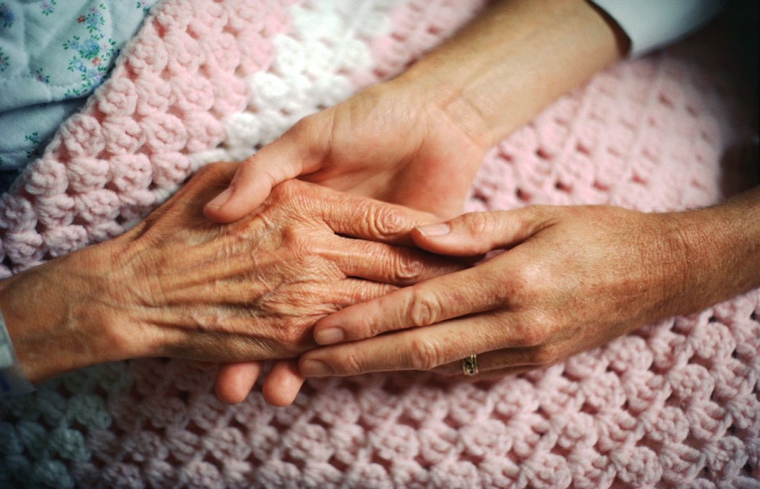
In conclusion ~
Mental Illness in the Elderly
Very complicated
Confounding diagnosis
Multiple medical problems
Physiologic changes
Stage of Life differences
Very gratifying

Slide 53
Thank you for your attention …
we can make a difference.

