Slide 1

The Civil Commitment Process:
What Happens After A Pink Slip?
Presented by Judge Elinore Marsh Stormer
and Magistrate Crystal Burnett
Notes:
“ Probate Court Services Related to Persons With Mental Illnesses, Addictions, and Cognitive Deficiencies“

Slide 2


Slide 3
Emergency Hospitalization: Who Can Issue a Pink Slip?
Police Officer
Psychiatrist
Licensed Clinical Psychologist
Medical Doctor
Health Officer*
*any public health doctor, nurse, or person authorized by a city or ADM board to perform the duties of a health officer.
Parole Officer

Slide 4
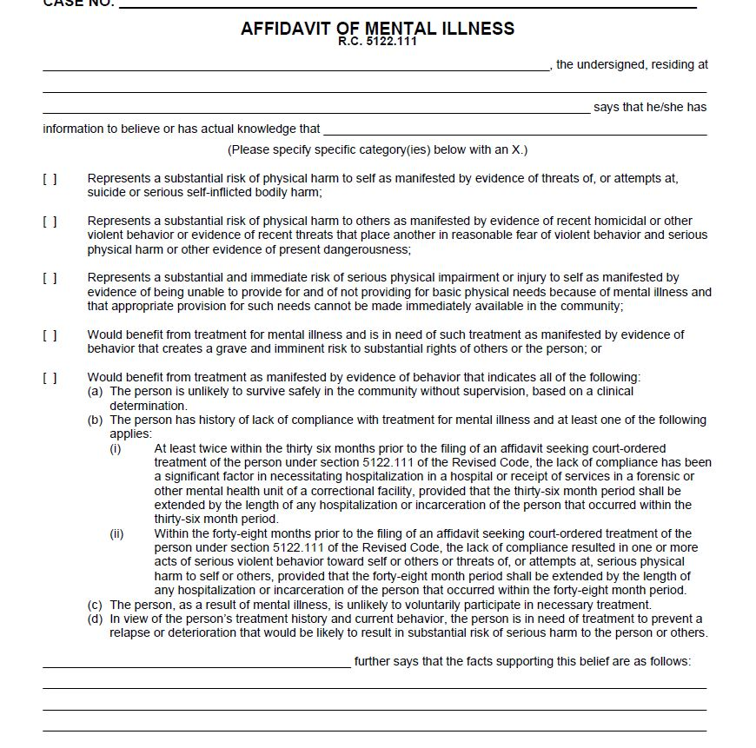
Affidavit

Slide 5
What’s Next After the Pink Slip?
Person is “Pink Slipped”
The Hearing is held at the Hospital with attorney for the person, the ADM Board, and the Magistrate
Hospital files Affidavit of Mental Illness at Probate Court
Probate Court Appoints an Attorney to Represent the Person
Probate Court Sets the Case for Hearing Before a Magistrate

Slide 6
Patient’s Rights
Right to attend the hearing.
Right to an independent psychiatric evaluation.
The right to have an attorney at the court’s expense.
Right to call witnesses.
Right to speak at the hearing or the right to refuse to speak.
Right to have a transcript of the hearing.
Right to appeal the decision at the court’s expense.

Slide 7


COMMITMENTS
If the evidence is clear and convincing that the person is mentally ill subject to court order, the probate court orders the person committed to the ADM Board for 90 days.
Upon release from the hospital:
CSS
New Day Court

Slide 8
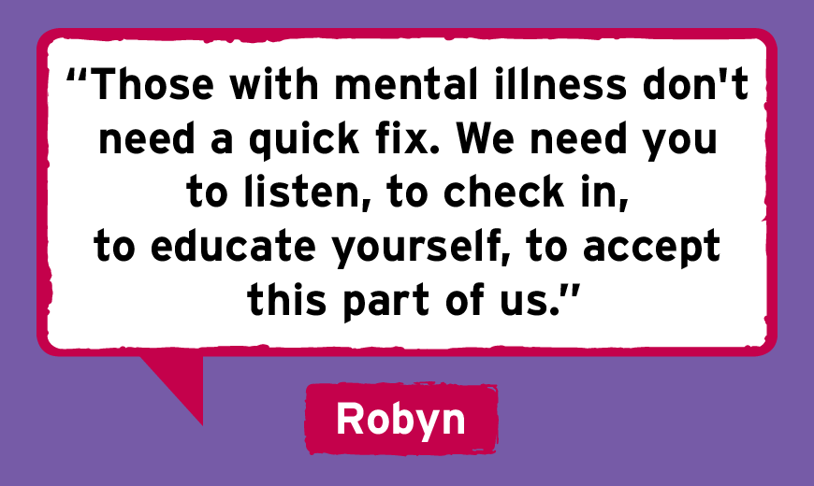

Slide 9
Continued Commitment: When 90 Days is Up But More Work Is Needed
Treating physician files an application for continued commitment 10 days prior to the expiration of the initial 90 day commitment.
The Court holds a hearing on the application.
If the Court finds by clear and convincing evidence that the person is mentally ill subject to court order, the person will be committed to the ADM board for an additional period of time.
Once under continued commitment, the person can be sent back to the hospital if necessary, and the Court holds a hearing on the change of status from “outpatient” to “inpatient” status.

Slide 10
Treatment Over Objection: Forced Medication
General Rule:
Everyone has a fundamental right to refuse medical treatment.
A court may issue an order permitting hospital physicians and/or nurses to administer antipsychotic drugs for an involuntarily committed patient if it finds by clear and convincing evidence, that:
The patient does not have the capacity to give informed consent.
It is in the patient’s best interest to take the medication, i.e. the benefits outweigh the side effects, and
There is no less intrusive option for treating the mental illness.

Slide 11
Outpatient Commitment
For many years, the Summit County Probate Court has supported outpatient commitment following release from the hospital.
After commitment is ordered, a patient is generally referred to Community Support Services for case management and treatment in the community.
The emphasis of OPC is to provide care for the individual so that he or she may live successfully in a non-hospital setting or in a least restrictive environment.
OPC is proven to reduce the likelihood of repeat hospitalizations and/or involvement in the criminal justice system.

Slide 12
Who is Served by Outpatient Commitment ?
Outpatient commitment is designed to specifically focus on individuals with a severe mental illness as defined by Ohio Revised Code 5122.01 (B), who were likely to struggle to adhere to voluntary treatment or were unwilling to subscribe to treatment because of their belief that they are not mentally ill (anosognosia).

Slide 13
How Does the Court Assist OPC?
Until 2016, once commitment took place and CSS became involved, the court engagement ceased, except for continued commitment hearings.
However, in January, 2016, the Court adopted an assisted outpatient treatment model (AOT) with some similarities to specialized dockets long used in the criminal court system.
This is the hallmark of the New Day Court.

Slide 14
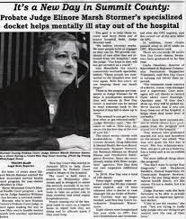

Slide 15
New Day Court
The Court’s Role:
The Participant’s Role:
Requires those civilly committed to appear regularly in court before Judge Elinore Marsh Stormer, the Probate judge; and
To motivate and encourage the individual to remain engaged with treatment.
During scheduled appearances, the participants speak with judge about how they are doing and can ask for help.
Participants “graduate” when their commitment or extended commitment expires.

Slide 16
Goals of New Day Court
To impress upon the individual that treatment adherence is expected and essential to avoiding re-hospitalization.
The hope is that the court experience helps the participant understand that a mental illness is a treatable condition which does not define the whole person.

Slide 17
New Day Court IS Not:
New Day Court is not to be confused with “Mental Health Court.”
It is not an extension of the criminal court system nor can a criminal court order an individual to participate in NDC.
Not designed to be used as an alternative to probation or parole.
Not in lieu of conviction or a diversion program.
Does not require the commission of a crime.
Does not impose criminal sanctions or confinement in a jail or other correctional facilities for non-compliance.

Slide 18
Summit County New Day Court Partners
Alcohol, Drug Addiction & Mental Health Board (ADM)
community mental health treatment agencies
community-based providers
hospitals
law enforcements
consumer and family advocates

Slide 19
Components of Assisted Outpatient Commitment
Provides a less restrictive alternative to involuntary hospitalization.
The treatment plan is tailored to the specific needs of the individual.
Individuals are closely monitored by a multidisciplinary team of mental health professionals in the community.
Reports on the individual’s condition and progress are reviewed monthly by the agencies Clinical Director and Chief Clinical Officer of the ADM Board.

Slide 20
Components of Assisted Outpatient Commitment
The treating psychiatrist can file an application for continued commitment with ADM for consideration.
AOT is the combination of a court order and community-based mental health services.
Regular progress appearances before the Court enhance the effectiveness of treatment and aid recovery.

Slide 21
Outcomes 2021 :
Not necessarily representative
Total # of participants 192
Graduated 73
Active Clients 119
Re-hospitalized while on OPC 6
Recommitted after OPC expired 7

Slide 22


