Slide 1


Children and Adolescents
Mental Health Needs Plus More!
Liz Cohen, MD

Slide 2

Opening Case
J is a 15 year old male seeing his doctor in the office for ADHD
J reports active suicidal ideation (new) with a plan of he was going to kill himself
Mom was unable to drive the client to the emergency department
Local EMS were called

Slide 3
Next Steps:
What would you do if you were called to evaluate this young man?
What would you want to know?
How would you gather information?

Slide 4

What Actually Happened:
Interrogation style
Officer found out child wasn’t taking medication (only for ADHD)
Chastised and blamed him that symptoms of depression were because he wasn’t taking medication
Assumed he wasn’t taking antidepressant
Child became visibly upset

Slide 5
Needless to say
It could have gone better…

Slide 6
Working With Kids

Slide 7
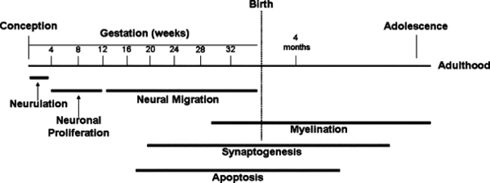
Development
Notes:
Development is very active in children and adolescents, not done until early adulthood.

Slide 8
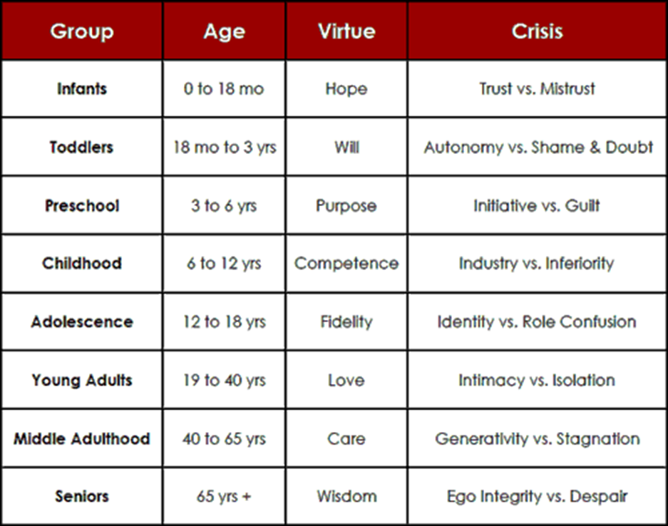
Erik Erikson
Notes:
Teens are working on figuring out who they actually are. Young adults may struggle with feeling connected to those around them.

Slide 9

Kids are not little adults
Notes:
Kids may not have the verbal communication skills that adults have
May not have the language to share what they are experiencing or feeling
May not be able to talk about how they are feeling or what they are feeling
May be ashamed, embarrassed, or fearful (especially in cases of abuse or neglect)
Kids may be struggling to understand who they are, this is part of typical development but can be confusing for those around the kids

Slide 10

Kids can Be Impulsive
Notes:
Kids are impulsive
Impulse control is one of the later things to develop (brain isn’t fully developed until about 25!)
Can have self harm or suicide attempts without being depressed

Slide 11

Who am I?
Notes:
Kids may be struggling to understand who they are, this is part of typical development but can be confusing for those around the kids
Normal part of development
Leads to pressure to try and figure out who they are and where they fit in
Social media
Increased eating disorders
Fear of missing out
Bullying 24/7
Sleep disruption
Substance use

Slide 12

Trauma Informed Interactions
Notes:
More than 2/3 of children reported some type of traumatic experience before they are 16- neglect, assault, violence, witnessing DV
1 in 7 children experienced abuse or neglect in the past year
1 in 5 children reported being bullied on school property
Assume that children/youth have experienced trauma
Create safety for the child and explain that they are safe
Be mindful of how you interact with children (give example of handshake)

Slide 13
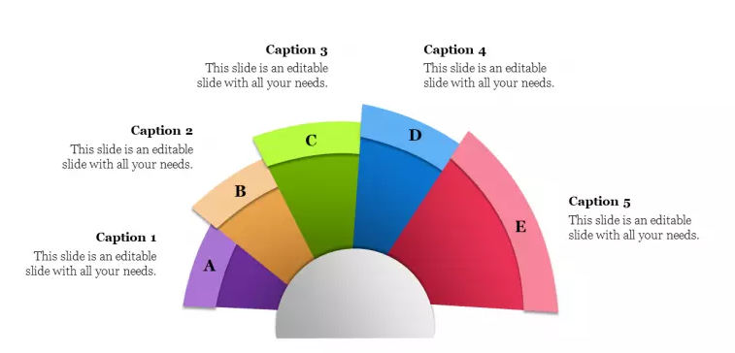
Spectrum of Local Services
Inpatient Services
IOP/PHP
Outpatient Services
Residential Treatment
PIRC
Notes:
PIRC- psychiatric intake response center, psychiatric specific emergency department, not all hospital systems have this. Staffed 24/7 with mental health professionals. High threshold for admission therefore often refer to other services
Outpatient- more of what you would expect. Will discuss more in another slide
Can be community mental health agency (CGFS, Red Oak, Coleman, CSS, Portage Path- for example)
Private Practice- Lifestance, for example. Take private insurance mainly. Less broad services. More typical individual work.
IOP- intensive outpatient program- after school, a few days a week. Akron Children’s, Cleveland Clinic, Laurelwood
PHP- Partial Hospitalization program- typically about 10 days, full day- school and therapy
Inpatient- “8100” at ACH, typically 3-5 days. Crisis stabilization and discharge planning. ACH, Cleveland Clinic, UH, Laurelwood
Residential Treatment- long term, 30-90 + days, hard to access, very costly

Slide 14
Spectrum of CGFS Services
Medication Management
Case Management
Family Therapy
Home Based
Individual Counseling
Notes:
People assume we only see kids, not true. We see adults as well
Outpatient Counseling- more of what people think about. Typically client goes into the office, can be community based
Family therapy- typically someone different than individual counselor, bring family members together
Med management- psychiatrist or advanced practice registered nurse to provide medication treatments
Case management- therapeutic behavioral supports, advocate and coordinate, can go to schools, home, doctor’s appointments, practice skills that they learn in therapy
Home based services- intensive home based or intensive dual diagnosis services

Slide 15
Other CGFS Services
School based
Integrated care (in pediatrician’s offices)
Skills groups
SBPP
Notes:
School based- 7 different school districts
Integrated care- decrease stigma, increase access
Skills groups- for young kids through teens
Sexual behavior problem program- court mandated offenders

Slide 16
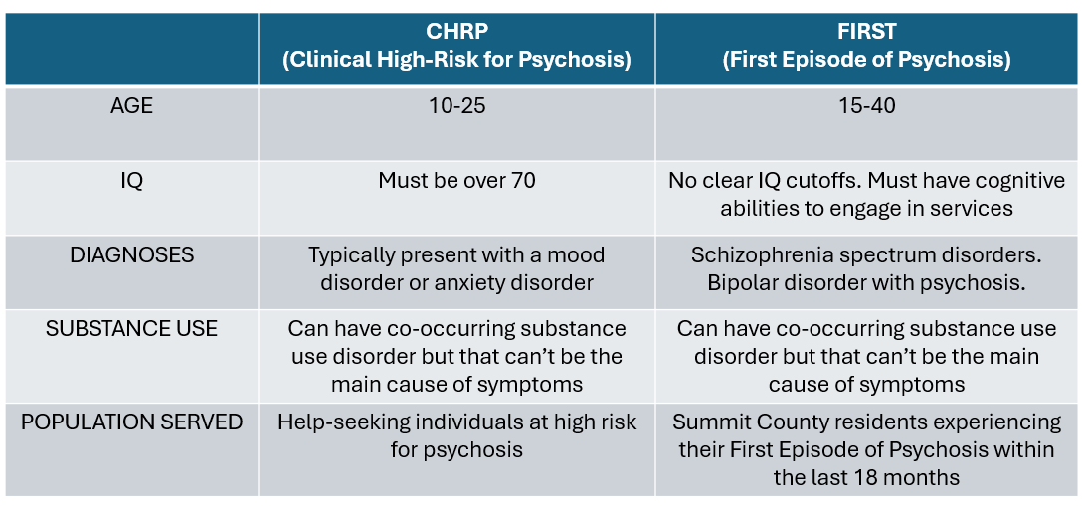
Specialty Services
Notes:
CCAN- clinical high risk for psychosis
FIRST- have experienced their first episode of psychosis, typical referral comes from hospital system

Slide 17
Tips For Engaging Kids

Slide 18
Remember- the child and family are in crisis
Try and connect with the child
Cartoon/sports shirts? Hobbies? Jokes?
If possible, try and assess child separately from parent
Suicidal ideation
Homicidal ideation
Psychosis (hallucinations, seeing things, hearing things, confusion)
Drugs
Abuse and Neglect

Slide 19
Don’t make assumptions
Remember the impact of COVID- still lingering for youth
Disruption of daily life
Stressors at home
Lack of social interactions
Online life vs. in person life
School changes and challenges
Notes:
Assumptions- don’t assume that just because a family has high income that they couldn’t have mental health struggles, abuse, domestic violence, or abuse/neglect in the home

Slide 20

Closing Case
L is a young adult involved in the FIRST program. Had been hospitalized out of state, returned to Ohio and was living with parents.
Parents noted escalating behavior and called local EMS
Police came and didn’t have full history
L was not brought to hospital

Slide 21

Closing Case
L’s mom called me and said “the police won’t do anything and they said it wasn’t worth it to take her to the hospital”
Mom stated it was not a positive interaction with local police
Notes:
I appreciate the work that you do and felt that I was getting just one side of the story

Slide 22
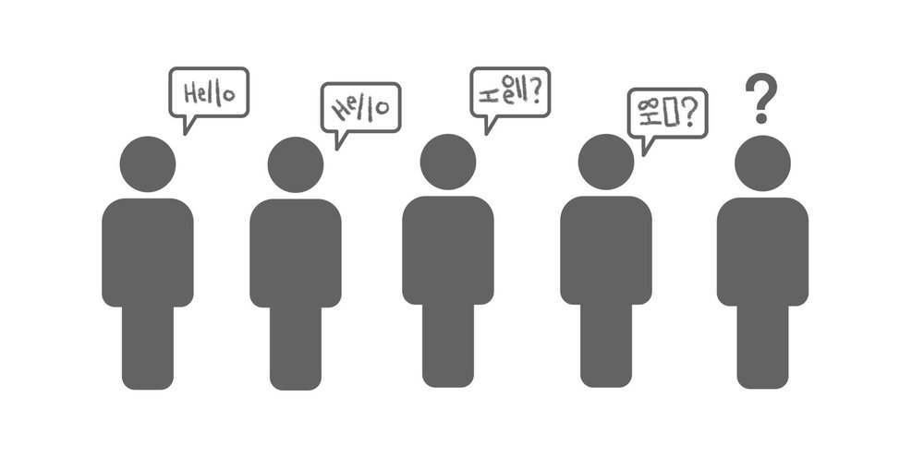
Closing Case
In order to minimize the confuse, called the CIT head of the police jurisdiction
Explained what I had been told
He shared what his officer’s experience had been
Explained the background
Felt more prepared
Notes:
I appreciate the work that you do and felt that I was getting just one side of the story

Slide 23

Closing Case
Police were summoned back to the home later that day
Ultimately brought to ED for evaluation
L was hospitalized and now engaged in treatment

Slide 24
Why CIT Rocks!
Less use of force
Increased safety of First Responders and consumers/callers
Enhanced communication
Better connection to mental health
Good feeling when I can share this resource with family members who are concerned or scared for their loved one

Slide 25

Liz Cohen, M.D.
Child Guidance and Family Solutions
cohee@cgfs.org
330-384-2855

